Slide 1

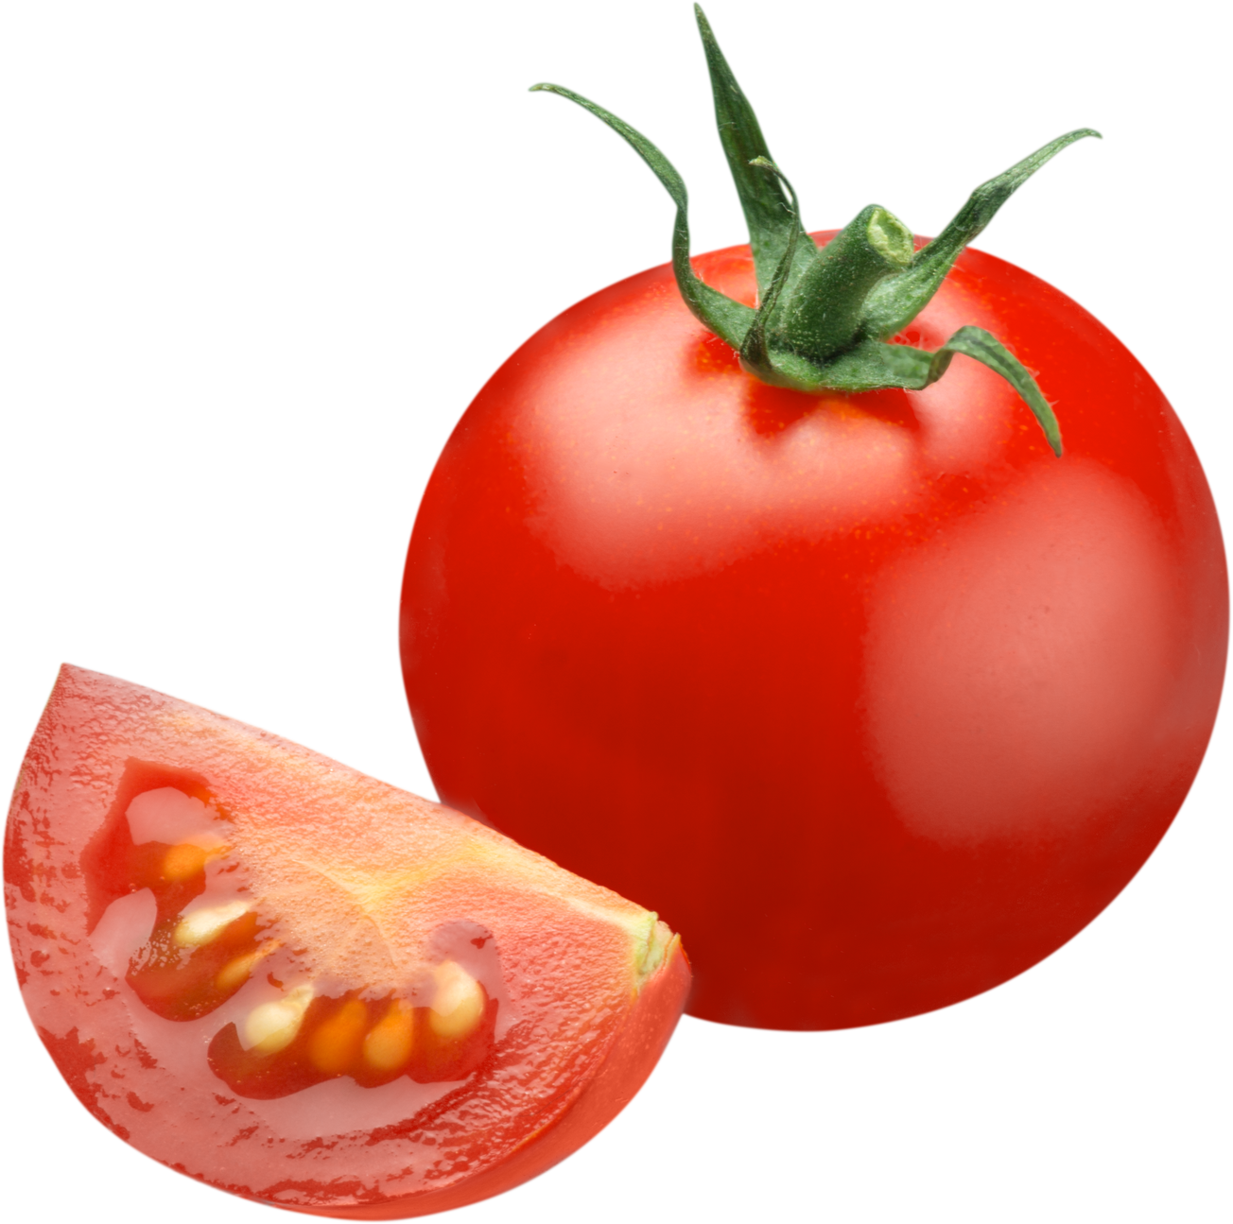




Effects of Fermentation Parameters on Single Cell Protein Production from Tomato Pomace
Ayşe Sultan Akgün
Biotechnology, METU
Prof. Dr. Mecit Halil Öztop
Food Engineering, METU

Slide 2
INTRODUCTION

Slide 3
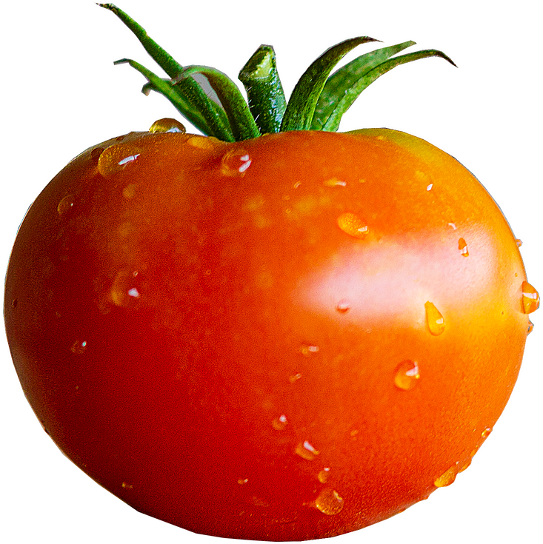


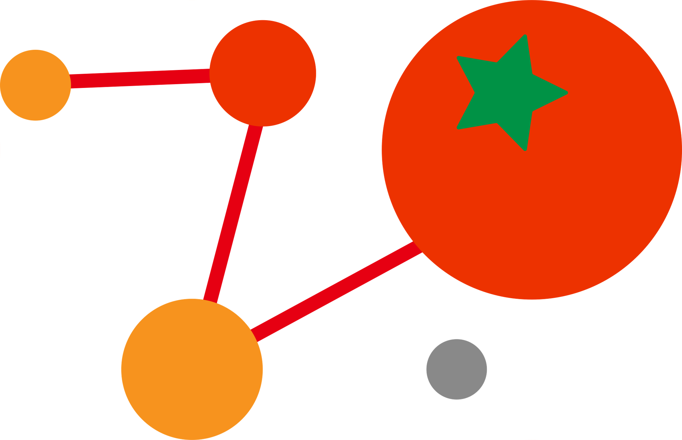


Widely consumed vegetable
Contain beneficial components;
Lycopene, phenolics, organic acids and vitamins
Consumption;
  Fresh vegetable
  Tomato paste
  Juice
  Sauce
  Puree
  Ketchup
Notes:
Tomatoes are a widely consumed vegetable and are known to contain beneficial components such as lycopene, phenolics, organic acids, and vitamins. In addition to being used as a fresh vegetable, tomatoes are also processed into various products such as paste, juice, sauce, puree, and ketchup.

Slide 4
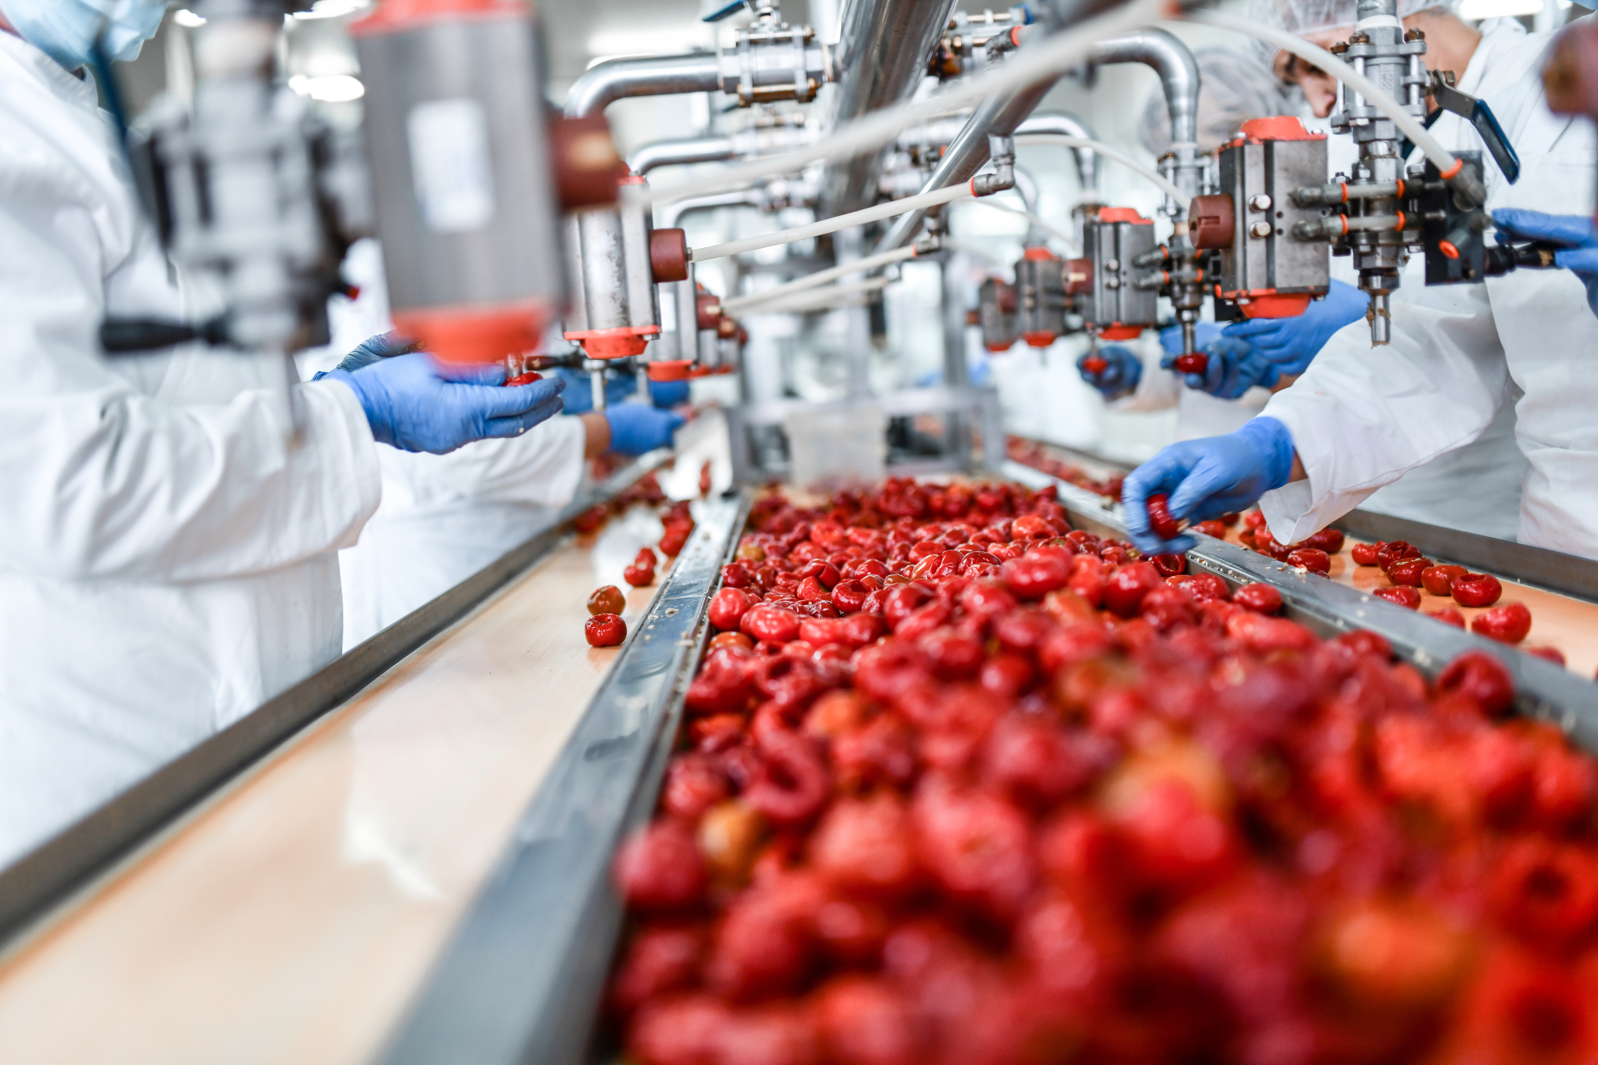

Tomato processing
By product tomato pomace
3-5%
Consists of peel, seed and pulp
Notes:
During the processing of these products, a by-product called tomato pomace is generated, which mainly consists of peels, seeds, and a small amount of pulp. On average, tomato pomace accounts for around 3-5% of the raw material used.

Slide 5
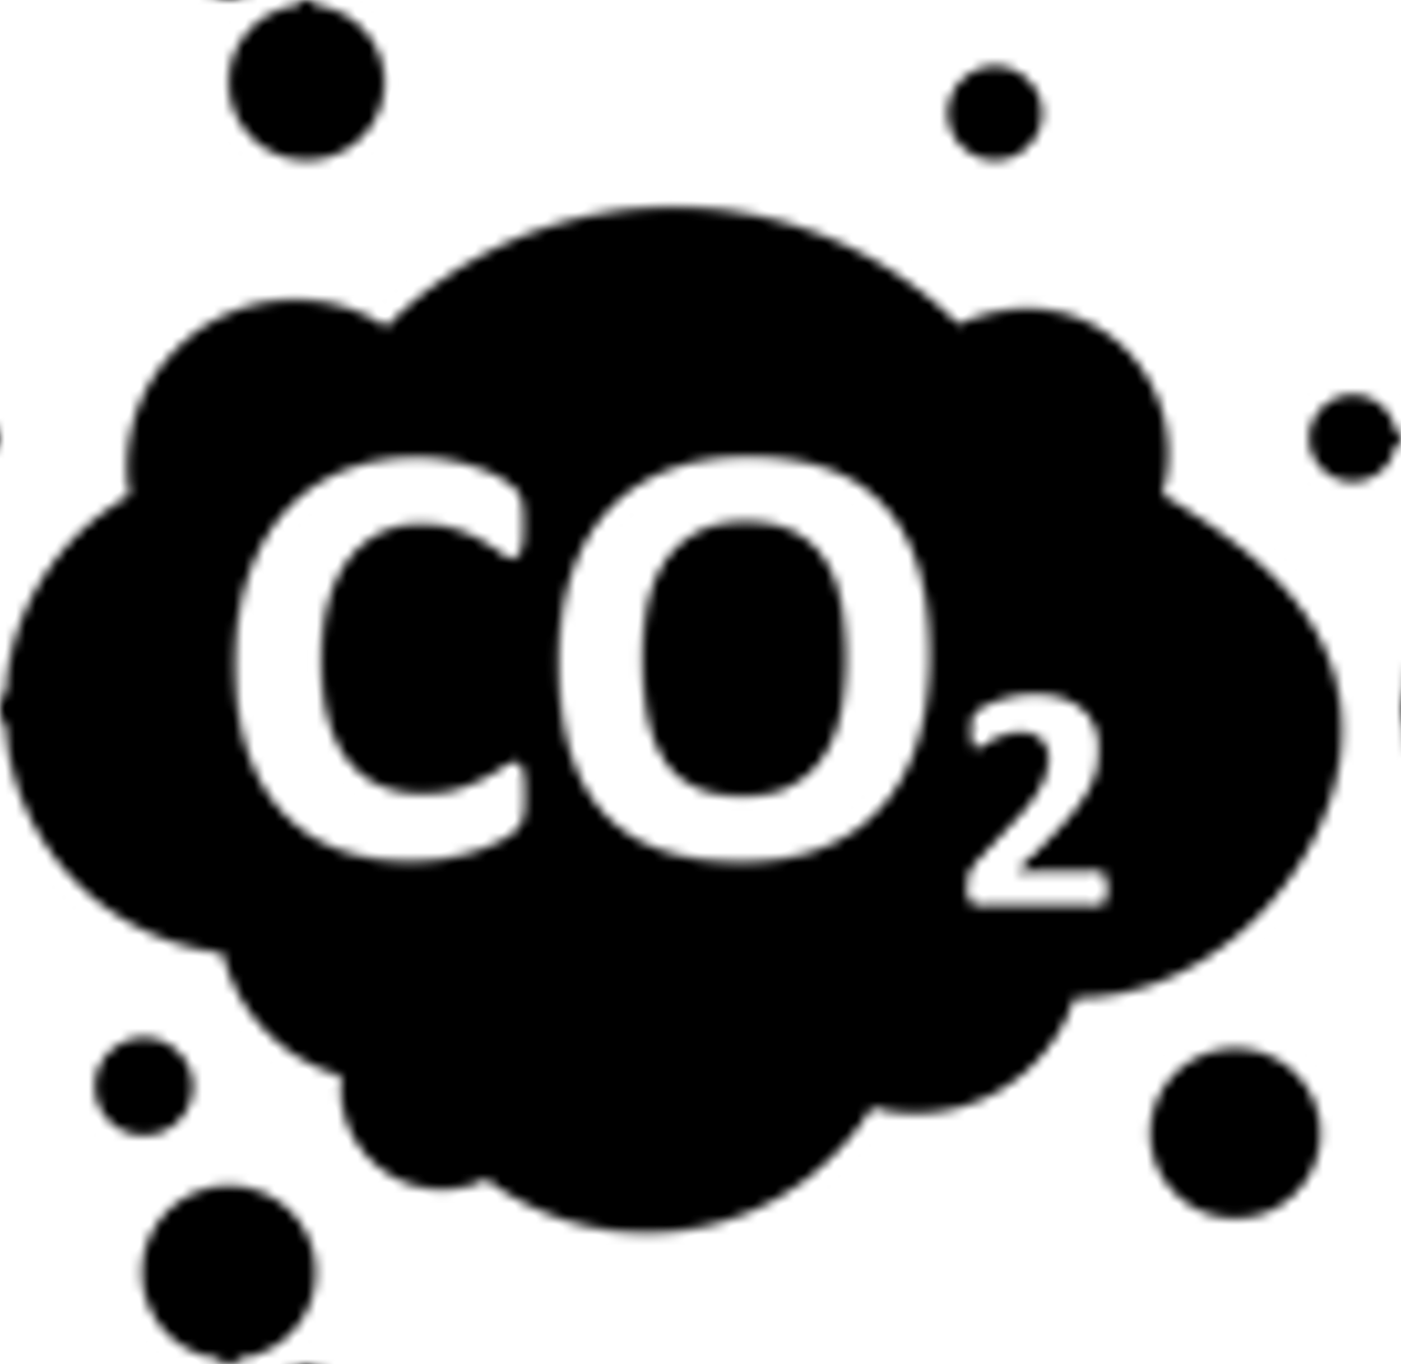


WHY TOMATO POMACE?
Over 80% of consumed tomatoes are processed products
Globally, 5.4-9 million tonnes/year tomato pomace is produced!
Challenge for disposal or utilization in the food industry!
Improper disposal
Waste of resources
Environmental burden
Notes:
Why we are talking about tomato pomace. Because over 80% of consumed tomatoes are processed products and as a result, an estimated 5.4-9.0 million tonnes of tomato pomace are produced globally, which presents a challenge for disposal or utilization in the food industry. Improper disposal can lead to environmental burdens and waste of resources due to the high water content and nutrient richness of tomato pomace. However, the rational utilization of tomato pomace can transform it into usable resources

Slide 6

WHY TOMATO POMACE?
Over 80% of consumed tomatoes are processed products
Globally, 5.4-9 million tonnes/year tomato pomace is produced!
Challenge for disposal or utilization in the food industry!
Improper disposal
Waste of resources
Environmental burden
Bio-Refinery
Notes:
through bio-refinery.

Slide 7
38% dietary fiber
21% protein
13% fat
Notes:
Tomato pomace has already had protein in the composition due to containing seeds. Dried tomato pomace is composed of 38% dietary fiber, 21% protein, 13% fat. However, more protein can be obtained from tomato pomace by using it as raw material to conduct fermentation and produce single-cell protein.

Slide 8
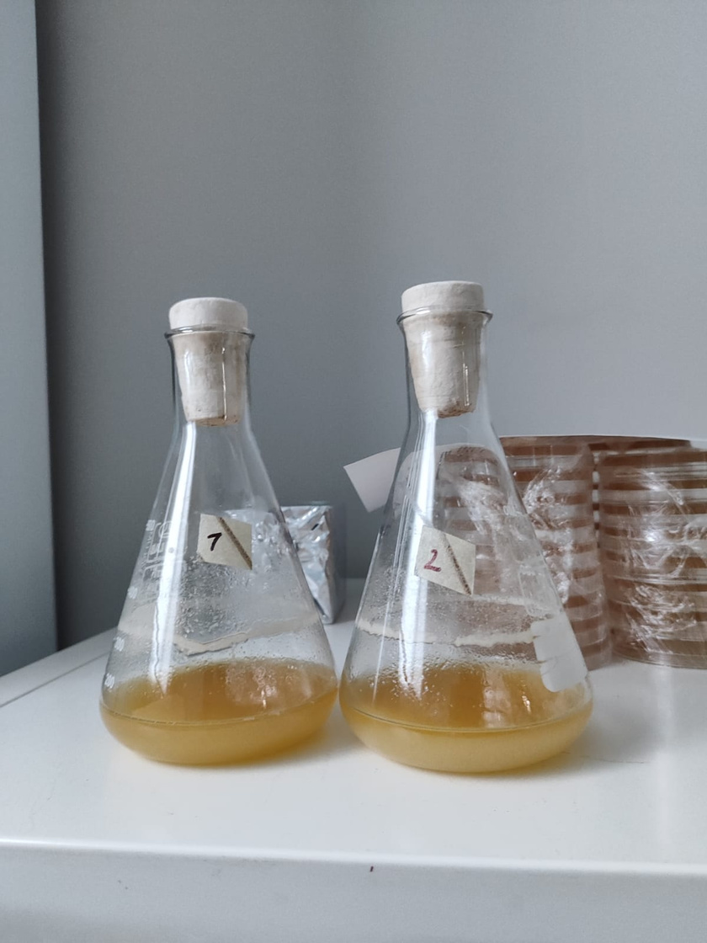
Saccharomyces cerevisiae
  Most widely used yeast for biological studies
  Aeration is main important factor in its growth
  Has fermentative capabilities to utilize sucrose, glucose, fructose and maltose as carbon sources
  High interest because it is GRAS
Notes:
Saccharomyces cerevisiae was known as the most widely used yeast for biological studies and applications as well as single cell protein production. Aeration is a main important factor in S. cerevisiae growth. S. cerevisiae has fermentative capabilities to utilize sucrose, glucose, fructose, and maltose as carbon sources and produce alcohol under anaerobic conditions. It has become a significant research interest because it is GRAS (generally recognized as safe) microorganism.

Slide 9
MATERIAL & METHODS
Notes:
In this study, tomato pomace is used as carbon source in the fermentation to produce single cell protein by using Saccharomyces cerevisiae.

Slide 10




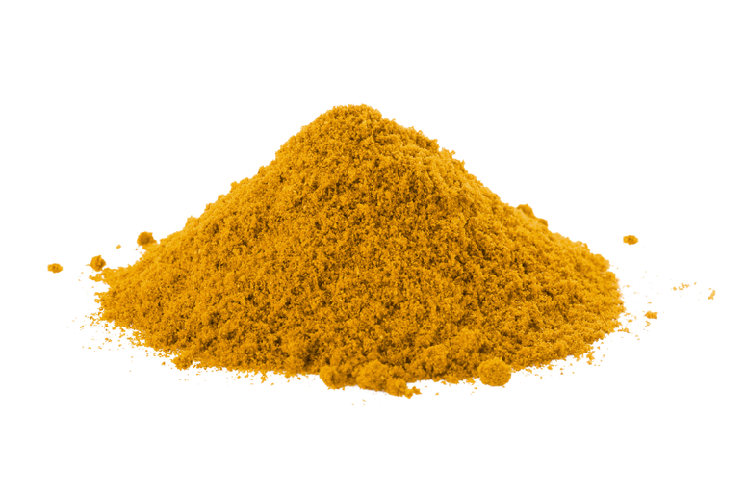



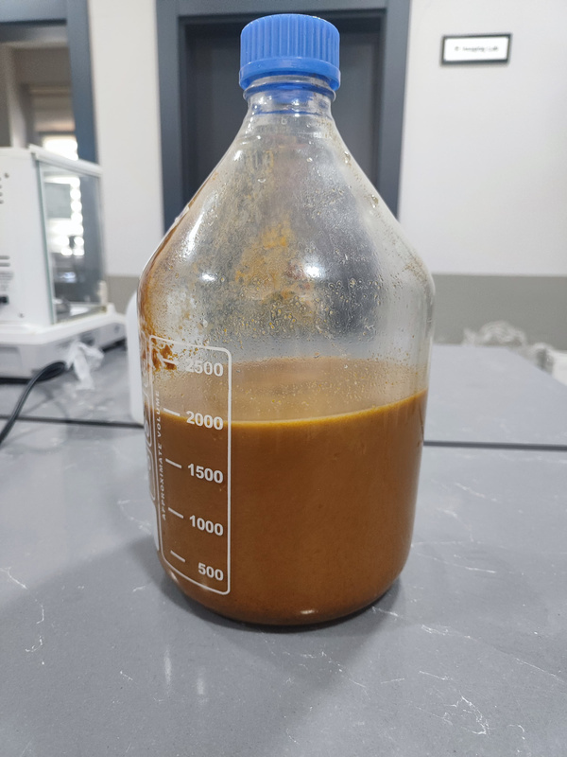
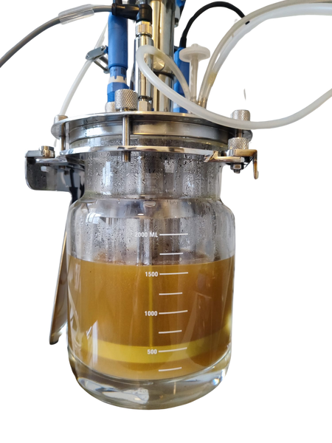
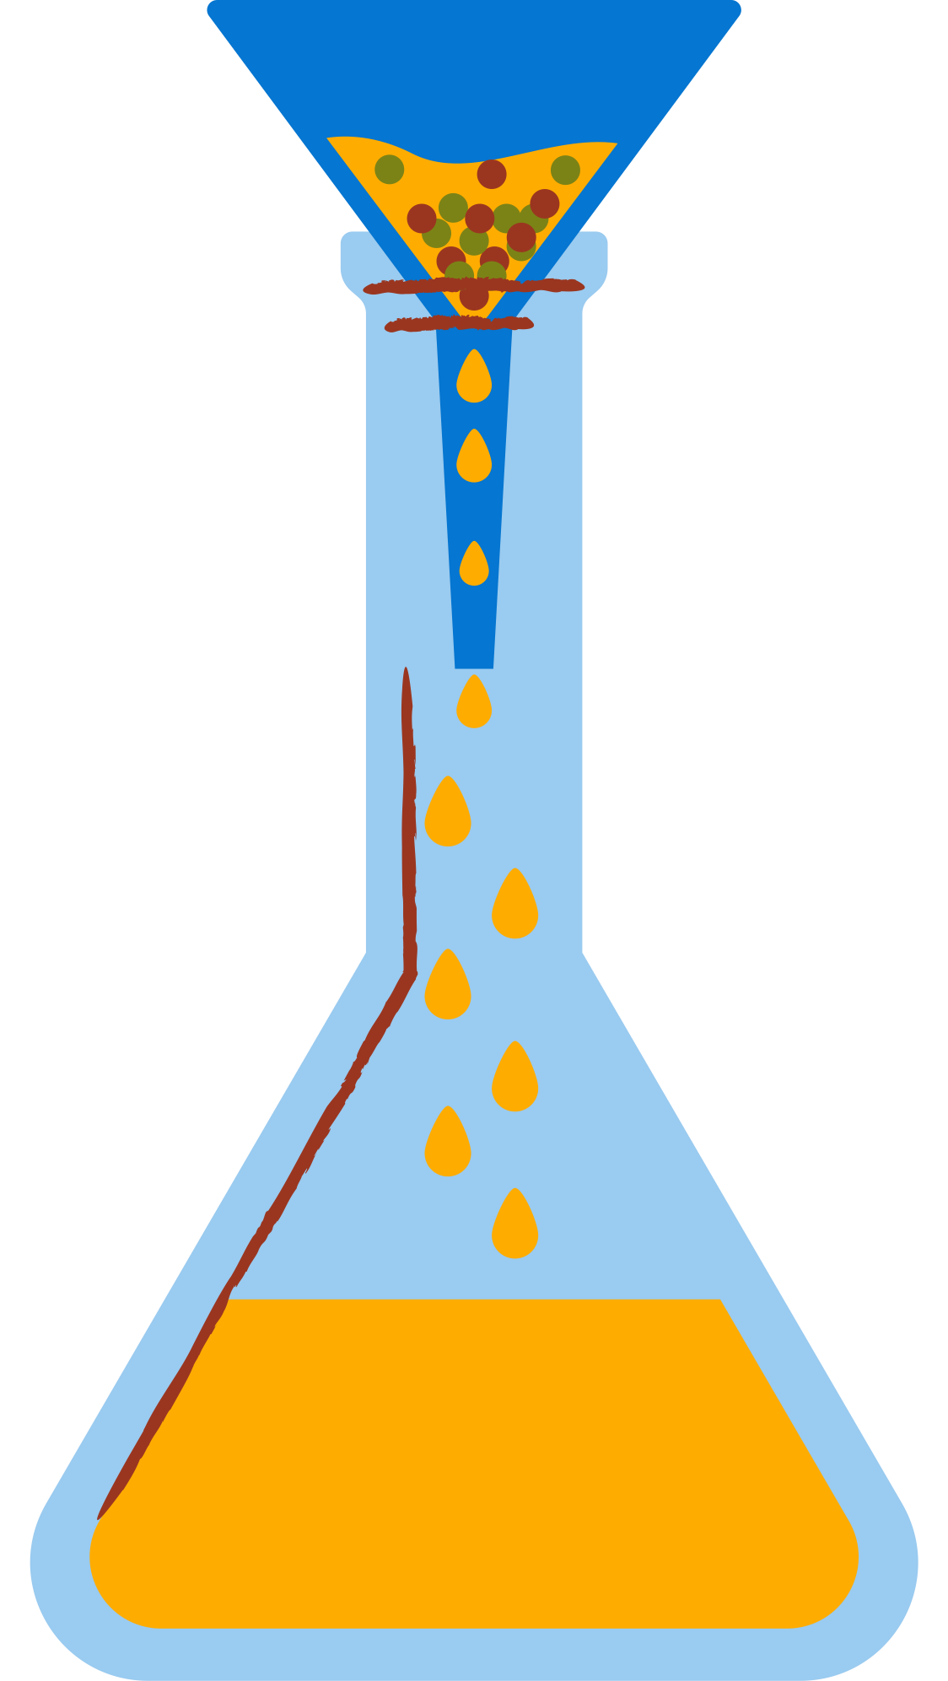
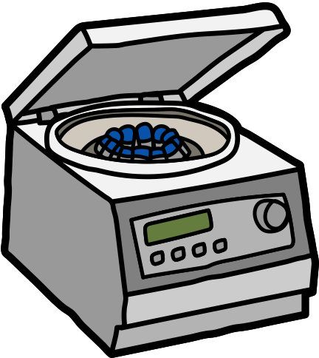

Fermentation Media Preparation
Cellulase and pectinase
Hydrothermal Pretreatment
Enzymatic Hydrolysis
Tomato pomace
50 C, 75 rpm for 18 h
121 C, 15 min
After hydrolysis
Filtration
Centrifuge
1.5 L working
volume
Notes:
First, ground tomato pomace was hydrothermally pretreated at 121 degree 15 min in autoclave. After pretreatment and enzymatic hydrolysis was applied at 50 degree 75 rpm for 18 hours with the addition of cellulase and pectinase enzymes. After hydrolysis, we obtained a slurry and filtration was conducted to obtain sugar solved liquid as fermentation media. Then, centrifugation was done to remove nonsoluble residuals. And 1.5 L fermentation media obtained and poured into a 3-L bioreactor.

Slide 11
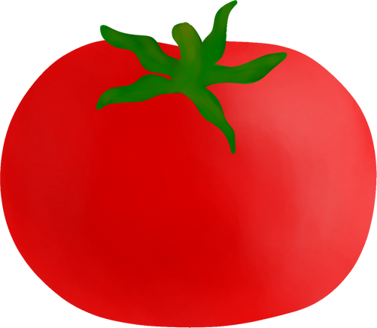




Experimental Design
Inoculum
volume
Fermentation
period
Solid Load
(w/v)
(v/v)
(day)
5%
10%
15%
1%
2%
3%
1
3
5
Notes:
For the fermentation experimental design was conducted as shown in here. We have selected three factors and three levels for each factor. Solid load, inocolum volume and fermentation period were selected as factors. For solid load 5, 10 and 15% tomato pomace was used. Inoculum volume levels were studied as 1, 2 and 3%. And for fermentation period day 1, 3 and 5 were selected.

Slide 12
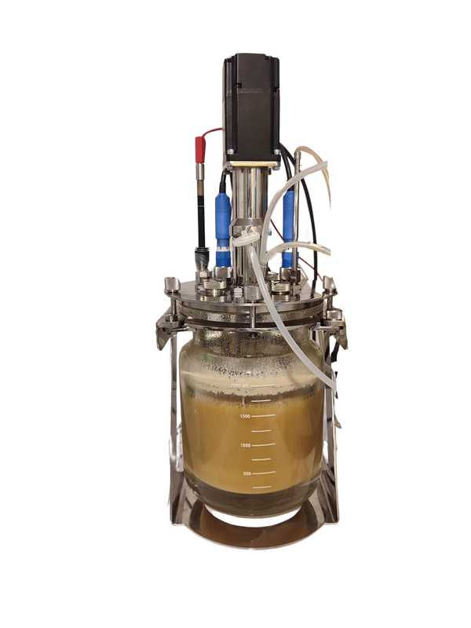
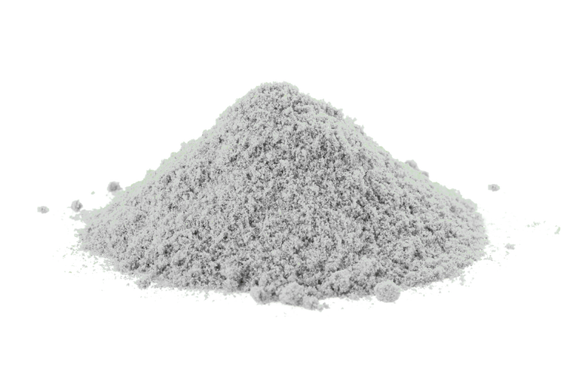


Fermentation Procedure
30 C, pH 5.0
200 rpm
Before
fermentation
After
fermentation
Centrifuge
Collecting
biomass
Dried biomass
Ready
for analysis!
Saccharomyces cerevisiae
Notes:
Fermentation was conducted at 30 degree pH 5 and 200 rpm. Saccharomyce cerevisiae was used as microorganism. Once the fermentation was completed, centrifugation was performed to collect biomass and it is dried for further analysis.

Slide 13
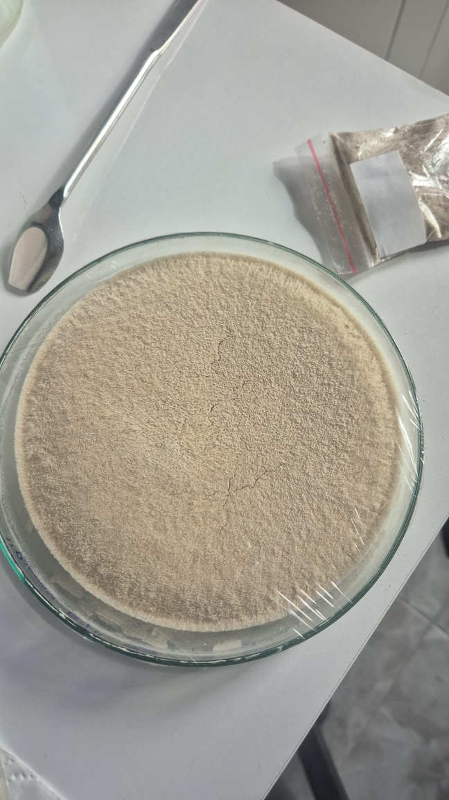
Analysis of Reducing Sugar Content
and Biomass Concentration
  Sampling each day
  Reducing sugar analysis by DNS method
  Optical density at 600 nm and converted to dry cell weight
After Fermentation Completed
  Biomass collected by centrifuge and dried
  Weight is measured
  Total protein content by Kjeldahl
Notes:
I took samples everyday including second and forth days. Each day reducing sugar analysis and optical density analysis were conducted. For reducing sugar analysis, DNS method is used. Optical density measured at 600 nm and later converted to dry cell weight using the standard curve which is generated using diluted growth media between 0,05 and 1.0 OD. Cellulase acetate filters were used to collect cells and weigh is measured after drying. When the fermentation was completed, biomass was collected by centrifuge and dried. Weight of final biomass was recorded and total protein content was measured by Kjeldahl.

Slide 14
RESULTS & DISCUSSION
Notes:
Now I will share my results.

Slide 15
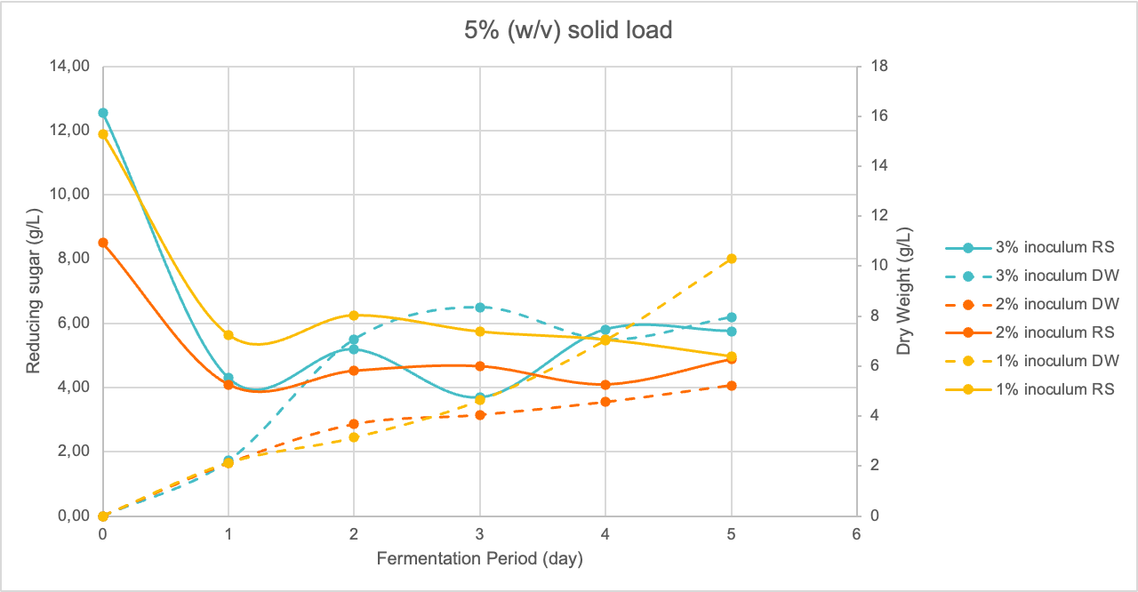
Figure 1. Reducing sugar concentration and dry weight change on media prepared with 5% w/v solid load
Notes:
I have collected each inoculum and fermentation data under same solid load to compare inoculum volume results. When I use 3% inoculum volume the trend in the graph shows growth plateaus or declines due to substrate depletion or accumulation of inhibitory compounds after 3 days of fermentation. Slow increase in biomass concentration of 2% inoculum usage may be caused by low initial reducing sugar content compared to other batches. The highest biomass concentration was obtained for 5% solid laod when I use 1% inoculum volume after 5 days fermentation.

Slide 16
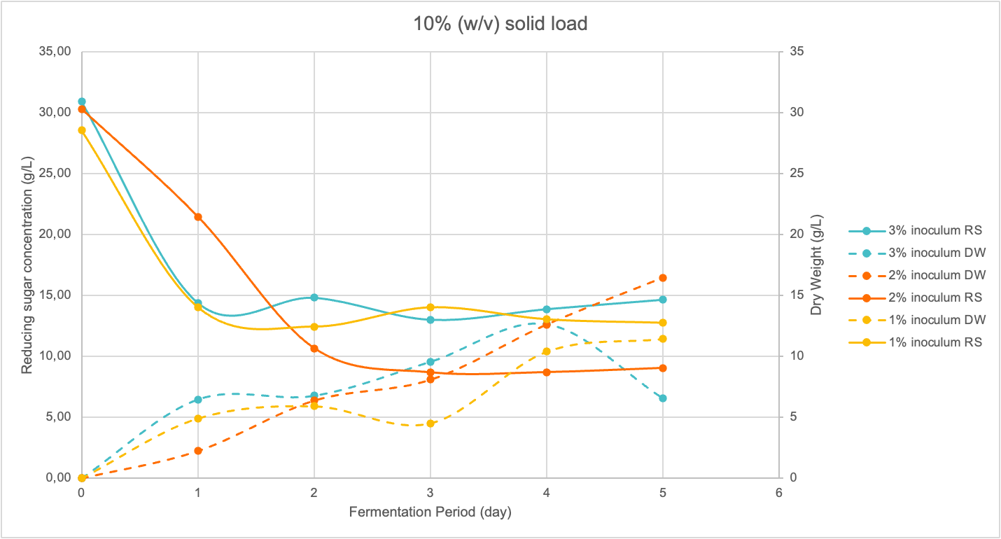
Figure 2. Reducing sugar concentration and dry weight change on media prepared with 10% w/v solid load
Notes:
When I use 10% solid load in the fermentation, all the initial reducing sugars were close to each other. Again biomass concentration started decrease after 4 days of fermentation with 3% inoculum volume usage. After 1 day fermentation reducing sugar concentrations were decreased for 1 and 3 % inoculum usage. On the other hand, when 2% inoculum volume was used, reducing sugar concentration continued to decrease on second day of fermentation. So, the biomass production continued and I obtained highest biomass concentration under these conditions. I have started a batch under these conditions to test whether I will obtain same results or not. It is the second day of fermentation and reducing sugar continues to decrease while I can observe rapid biomass growth.

Slide 17
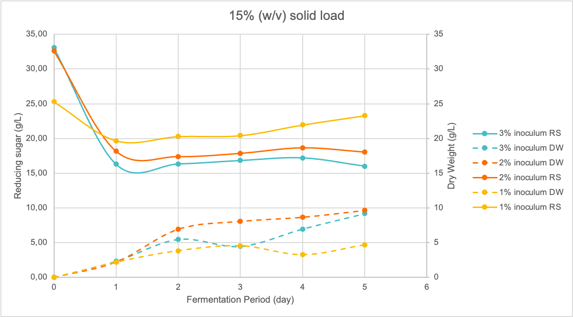
Figure 3. Reducing sugar concentration and dry weight change on media prepared with 15% w/v solid load
Notes:
When we use 15% solid load, the obtained biomass concentration was not higher than 10% solid load. 3% inoculum consumed more sugar and decrease in reducing sugar continued on second day too. biomass accumulation is positively correlated with fermentation time up to an optimal duration (around 4–5 days), after which growth slows or declines, especially at higher solid loads.

Slide 18
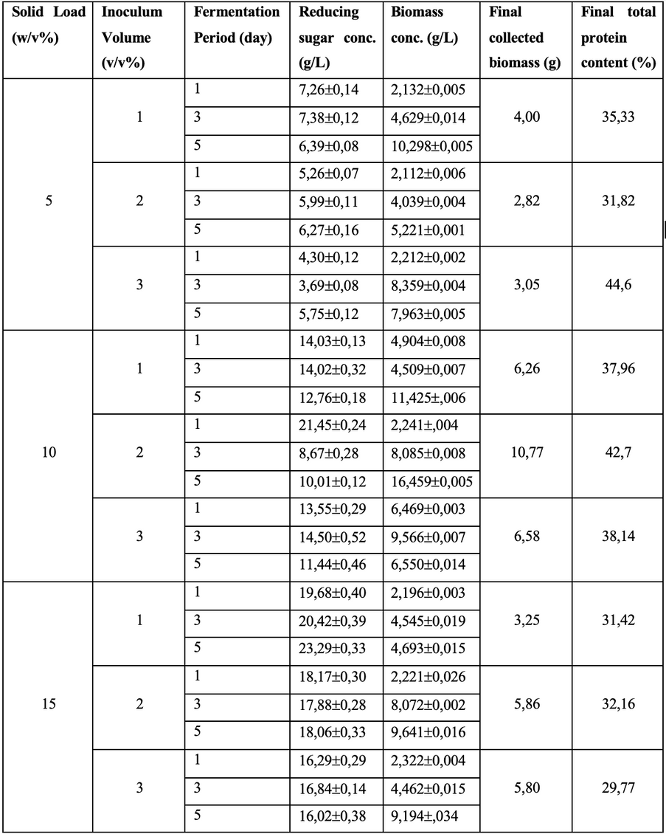
Effects of Solid Load
  Solid load from 5% to 15% (w/v) generally led to higher biomass concentrations
  The highest biomass concentration 16.459 g/L at 10% solid load, with 2% inoculum and 5 days of fermentation
  At 15% solid load and 2% inoculum, after 5 days 9.641 biomass conc, lower than the maximum observed at 10%
  No significant differences were observed among 5%, 10%, and 15% solid loads on biomass concentration
Notes:
I would like to continue with effects of each parameters starting from solid load. Solid load from 5% to 15% (w/v) generally led to higher biomass concentrations and greater final collected biomass. The highest biomass concentration was obtained as 16.459 g/L at 10% solid load, with 2% inoculum and 5 days of fermentation. Final collected biomass was 10.77 g and 42,7% protein was found in this biomass. At 15% solid load and 2% inoculum, after 5 days 9.641 biomass concentration was obtained lower than the maximum observed at 10%. Extremely high solid loads (e.g., 15%) did not always result in proportional increases in biomass, possibly due to mass substrate inhibition. This suggests that there is an optimal solid load for maximizing biomass production, beyond which efficiency declines. However, statistically, no significant differences were observed among 5%, 10%, and 15% solid loads on biomass concentration, while it is significant factor for reducing sugar concentration.

Slide 19
Effects of Inoculum Volume
  At each solid load, increasing the inoculum from 1% to 2% (v/v) improved biomass concentration and protein content, especially at shorter fermentation periods
  Inoculum volume (1%, 2%, 3%) did not significantly influence biomass concentration and reducing sugar concentration.
Notes:
I will continue with the effects of inoculum volume. At each solid load, increasing the inoculum from 1% to 2% (v/v) improved biomass concentration and protein content, especially at shorter fermentation periods. At 10% solid load and 2% inoculum, the biomass concentration after 5 days was 16.459, compared to 11.425 with 1% inoculum. Higher inoculum volumes can enhance substrate utilization and accelerate fermentation kinetics, though excessively high inoculum may lead to nutrient competition and decreased yield. Statistically, inoculum volume (1%, 2%, 3%) did not significantly influence biomass concentration and reducing sugar concentration.

Slide 20
Effects of Fermentation Period
  After 1 day of fermentation, the reducing sugar decreased significantly
  Selection of the periods 1, 3 and 5 days didn’t show the decrease in reducing sugar
  Hydrolysis of complex carbohydrates may increase reducing sugar concentration at intermediate time points
  A significant difference (p < 0.05) was detected between 1 day and longer periods (3 days, 5 days)
  Extended fermentation enhances biomass yield
Notes:
Lastly the effects of fermentation period. After 1 day of fermentation, the reducing sugar decreased significantly almost like halved. Selection of the periods 1, 3 and 5 days didn’t show the decrease in reducing sugar. Mostly, I can see the reducing sugar change from initial to first day. Hydrolysis of complex carbohydrates may increase reducing sugar concentration at intermediate time points. So, we can see some increases in reducing sugar after 2 days. A significant difference (p < 0.05) was detected between 1 day and longer periods (3 days, 5 days). This confirms that extended fermentation enhances biomass yield.

Slide 21
CONCLUSION

Slide 22

Fermentation using tomato pomace has been studied to produce biomass in 3-L bioreactor
Optimal solid load (around 10% w/v) maximizes biomass production without causing substrate inhibition
Inoculum volume with a 2% (v/v) inoculum leading to efficient substrate utilization and biomass accumulation
The fermentation period significantly influences biomass yield, with an optimal duration of approximately 4-5 days
The highest biomass concentration obtained as 16.46 g/L with 42.7% protein content.
Notes:
during these 6 months, fermentation using tomato pomace has been studied to produce biomass in 3-L bioreactor. The results demonstrate that an optimal solid load (around 10% w/v) maximizes biomass production without causing substrate inhibition. Inoculum volume with a 2% (v/v) inoculum leading to efficient substrate utilization and biomass accumulation. Furthermore, the fermentation period significantly influences biomass yield, with an optimal duration of approximately 4-5 days, beyond which growth plateaus or declines due to substrate depletion or accumulation of inhibitory compounds. The highest biomass concentration was obtained as 16.46 g/L with 42.7% protein content.

Slide 23
References
•Agbor, V. B., Cicek, N., Sparling, R., Berlin, A., & Levin, D. B. (2011). Biomass pretreatment: Fundamentals toward application. Biotechnology Advances, 29(6), 675–685. https://doi.org/10.1016/j.biotechadv.2011.05.005
•Alancay, M. M., Lobo, M. O., Quinzio, C. M., & Iturriaga, L. B. (2017). Extraction and physicochemical characterization of pectin from tomato processing waste. Journal of Food Measurement and Characterization, 11(4), 2119–2130. https://doi.org/10.1007/s11694-017-9596-0
•Allison, B. J., Cádiz, J. C., Karuna, N., Jeoh, T., & Simmons, C. W. (2016). The Effect of Ionic Liquid Pretreatment on the Bioconversion of Tomato Processing Waste to Fermentable Sugars and Biogas. Applied Biochemistry and Biotechnology, 179(7), 1227–1247. https://doi.org/10.1007/s12010-016-2061-4
•Binod, P., Janu, K. U., Sindhu, R., & Pandey, A. (2011). Hydrolysis of Lignocellulosic Biomass for Bioethanol Production. In Biofuels (pp. 229–250). Elsevier. https://doi.org/10.1016/B978-0-12-385099-7.00010-3
•Germec, M., Tarhan, K., Yatmaz, E., Tetik, N., Karhan, M., Demirci, A., & Turhan, I. (2016). Ultrasound‐assisted dilute acid hydrolysis of tea processing waste for production of fermentable sugar. Biotechnology Progress, 32(2), 393–403. https://doi.org/10.1002/btpr.2225
•Grassino, A. N., Brnčić, M., Vikić-Topić, D., Roca, S., Dent, M., & Brnčić, S. R. (2016). Ultrasound assisted extraction and characterization of pectin from tomato waste. Food Chemistry, 198, 93–100. https://doi.org/10.1016/j.foodchem.2015.11.095
•Hijosa-Valsero, M., Garita-Cambronero, J., Paniagua-García, A. I., & Díez-Antolínez, R. (2019). Tomato Waste from Processing Industries as a Feedstock for Biofuel Production. BioEnergy Research, 12(4), 1000–1011. https://doi.org/10.1007/s12155-019-10016-7
•Johannes, L. P., & Xuan, T. D. (2024). Comparative Analysis of Acidic and Alkaline Pretreatment Techniques for Bioethanol Production from Perennial Grasses. Energies, 17(5), 1048. https://doi.org/10.3390/en17051048
•Kılmanoğlu, H., Hoşoğlu, M. İ., Güneşer, O., & Yüceer, Y. K. (2021). Optimization of pretreatment and enzymatic hydrolysis conditions of tomato pomace for production of alcohols and esters by Kluyveromyces marxianus. LWT, 138, 110728. https://doi.org/10.1016/j.lwt.2020.110728
•Lu, Z., Wang, J., Gao, R., Ye, F., & Zhao, G. (2019). Sustainable valorisation of tomato pomace: A comprehensive review. Trends in Food Science & Technology, 86, 172–187. https://doi.org/10.1016/j.tifs.2019.02.020
•Mankar, A. R., Pandey, A., Modak, A., & Pant, K. K. (2021). Pretreatment of lignocellulosic biomass: A review on recent advances. Bioresource Technology, 334, 125235. https://doi.org/10.1016/j.biortech.2021.125235
•Mechmeche, M., Kachouri, F., Chouabi, M., Ksontini, H., Setti, K., & Hamdi, M. (2017). Optimization of Extraction Parameters of Protein Isolate from Tomato Seed Using Response Surface Methodology. Food Analytical Methods, 10(3), 809–819. https://doi.org/10.1007/s12161-016-0644-x
•Miller, G. L. (1959). Use of Dinitrosalicylic Acid Reagent for Determination of Reducing Sugar. Analytical Chemistry, 31(3), 426–428. https://doi.org/10.1021/ac60147a030
•Mupondwa, E., Li, X., Tabil, L., Sokhansanj, S., & Adapa, P. (2017). Status of Canada’s lignocellulosic ethanol: Part II: Hydrolysis and fermentation technologies. Renewable and Sustainable Energy Reviews, 79, 1535–1555. https://doi.org/10.1016/j.rser.2016.11.037
•Nandal, P., Sharma, S., & Arora, A. (2020). Bioprospecting non-conventional yeasts for ethanol production from rice straw hydrolysate and their inhibitor tolerance. Renewable Energy, 147, 1694–1703. https://doi.org/10.1016/j.renene.2019.09.067
•Palmqvist, E., & Hahn-Hägerdal, B. (2000). Fermentation of lignocellulosic hydrolysates. II: Inhibitors and mechanisms of inhibition. Bioresource Technology, 74(1), 25–33. https://doi.org/10.1016/S0960-8524(99)00161-3
•Pocan, P., Bahcegul, E., Oztop, M. H., & Hamamci, H. (2018). Enzymatic Hydrolysis of Fruit Peels and Other Lignocellulosic Biomass as a Source of Sugar. Waste and Biomass Valorization, 9(6), 929–937. https://doi.org/10.1007/s12649-017-9875-3
•Qureshi, N., Singh, V., Liu, S., Ezeji, T. C., Saha, B. C., & Cotta, M. A. (2014). Process integration for simultaneous saccharification, fermentation, and recovery (SSFR): Production of butanol from corn stover using Clostridium beijerinckii P260. Bioresource Technology, 154, 222–228. https://doi.org/10.1016/j.biortech.2013.11.080
•Rorke, D. C. S., Suinyuy, T. N., & Gueguim Kana, E. B. (2017). Microwave-assisted chemical pre-treatment of waste sorghum leaves: Process optimization and development of an intelligent model for determination of volatile compound fractions. Bioresource Technology, 224, 590–600. https://doi.org/10.1016/j.biortech.2016.10.048
•Ruiz, H. A., Conrad, M., Sun, S.-N., Sanchez, A., Rocha, G. J. M., Romaní, A., Castro, E., Torres, A., Rodríguez-Jasso, R. M., Andrade, L. P., Smirnova, I., Sun, R.-C., & Meyer, A. S. (2020). Engineering aspects of hydrothermal pretreatment: From batch to continuous operation, scale-up and pilot reactor under biorefinery concept. Bioresource Technology, 299, 122685. https://doi.org/10.1016/j.biortech.2019.122685
•Ruiz, H. A., Hedegaard Thomsen, M., & Trajano, H. L. (Eds.). (2017). Hydrothermal Processing in Biorefineries. Springer International Publishing. https://doi.org/10.1007/978-3-319-56457-9
•Sarawan, C., Suinyuy, T. N., Sewsynker-Sukai, Y., & Gueguim Kana, E. B. (2019). Optimized activated charcoal detoxification of acid-pretreated lignocellulosic substrate and assessment for bioethanol production. Bioresource Technology, 286, 121403. https://doi.org/10.1016/j.biortech.2019.121403
•Stylianou, M., Laifi, T., Bennici, S., Dutournie, P., Limousy, L., Agapiou, A., Papamichael, I., Khiari, B., Jeguirim, M., & Zorpas, A. A. (2023). Tomato waste biochar in the framework of circular economy. Science of The Total Environment, 871, 161959. https://doi.org/10.1016/j.scitotenv.2023.161959
•Trombino, S., Cassano, R., Procopio, D., Di Gioia, M. L., & Barone, E. (2021). Valorization of Tomato Waste as a Source of Carotenoids. Molecules, 26(16), 5062. https://doi.org/10.3390/molecules26165062
•Tsai, M., Lee, W., Kuan, W., Sirisansaneeyakul, S., & Savarajara (Akaracharanya), A. (2018). Evaluation of different pretreatments of Napier grass for enzymatic saccharification and ethanol production. Energy Science & Engineering, 6(6), 683–692. https://doi.org/10.1002/ese3.243
•Vivek, N., Nair, L. M., Mohan, B., Nair, S. C., Sindhu, R., Pandey, A., Shurpali, N., & Binod, P. (2019). Bio-butanol production from rice straw – Recent trends, possibilities, and challenges. Bioresource Technology Reports, 7, 100224. https://doi.org/10.1016/j.biteb.2019.100224
•Yilmaz, E., Aydeniz, B., Güneşer, O., & Arsunar, E. S. (2015). Sensory and Physico‐Chemical Properties of Cold Press‐Produced Tomato ( Lycopersicon esculentum L.) Seed Oils. Journal of the American Oil Chemists’ Society, 92(6), 833–842. https://doi.org/10.1007/s11746-015-2648-x
•Zuorro, A., & Lavecchia, R. (2013). Optimization of Enzyme-Assisted Lycopene Extraction from Tomato Processing Waste. Advanced Materials Research, 800, 173–176. https://doi.org/10.4028/www.scientific.net/AMR.800.173

Slide 24

Duygu Menteş
Deniz Sevim Çabuk
Dila Çınar
Beste Naz İnce
Defne Gülçek
Ömer Alp

Slide 25


THANK YOU!
in/aysesultankurt
aysesultankurt@gmail.com
This study has recieved funding from the European Union's Horizon 2020-PRIMA Section I Program under grant agreement #2232 (ProxIMed)

