Slide 1








Enhancing chia seed protein recovery: a study
on AL/IEP, EA, HPH, US techniques
M. Eng. Simon Dirr^{1,2} Prof. Dr. Özlem Özmutlu^{1,2}
¹Faculty of Food Technology and Horticulture, University of Applied Sciences Weihenstephan-Triesdorf, Am Hofgarten 4, 85354 Freising, Germany
²Institute of Food Technology, University of Applied Sciences Weihenstephan-Triesdorf, Am Staudengarten 11, 85354 Freising, Germany
The PRIMA programme is supported under Horizon 2020, the European Union’s Framework Programme for Research and Innovation
Notes:
I changed the topic towards high preasure Homogenisation, but I added Enzyme assisted extraction as bonus ;) This work is supported under the PRIMA programme, which is part of the European Union’s Horizon 2020 Framework Programme for Research and Innovation."

Slide 2




Exploration and Implementation of Products with Alternative Proteins in Mediterranean Region
Transforming Protein Landscape in the Mediterranean
The PRIMA programme is supported under Horizon 2020, the European Union’s Framework Programme for Research and Innovation
Notes:
Our broader project is titled 'Exploration and Implementation of Products with Alternative Proteins in the Mediterranean Region', with the goal of Transforming the Protein Landscape in this area

Slide 3

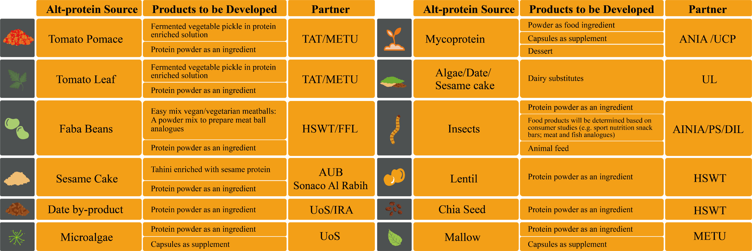

Our Worklist
The PRIMA programme is supported under Horizon 2020, the European Union’s Framework Programme for Research and Innovation
Notes:
As part of our worklist, we are focusing on chia, specifically exploring why it is a promising candidate for this research

Slide 4


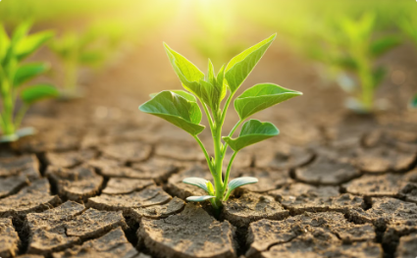
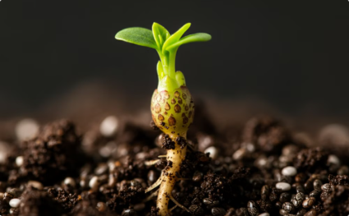
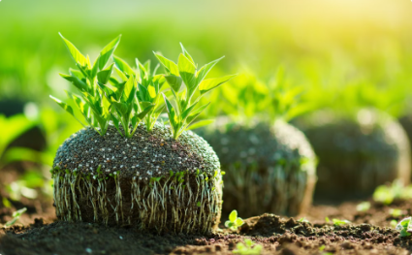
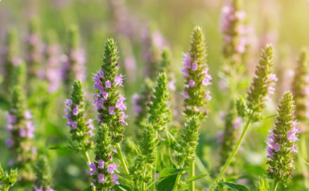


Why Chia: Thriving in Extreme Environments
Drought Tolerance
Heat Resilience
Chia's roots reach deep water sources, making it well-suited for arid regions [1]
Chia can tolerate high temperatures, a valuable trait for areas experiencing heat waves [1]
Soil Health
Erosion Reduction
Crop Yield
Chia's deep roots improve soil health by increasing aeration and water infiltration, leading to greater fertility [1]
Chia's extensive root system prevents soil erosion, protecting topsoil [1]
Chia can achieve high yields in marginal lands. Chia up to 2150 kg/ha [2] Chickpea: 2000 kg/ha [3] Lentils: 1200 kg/ha [4]
The PRIMA programme is supported under Horizon 2020, the European Union’s Framework Programme for Research and Innovation
Notes:
So, why chia? Chia is particularly interesting because of its ability to thrive in extreme environments. It exhibits drought tolerance as its roots reach deep water sources, making it well-suited for arid regions. Chia also has heat resilience, tolerating high temperatures which is valuable for areas experiencing heat waves. Furthermore, chia contributes to soil health; its deep roots improve aeration and water infiltration, leading to greater fertility. The extensive root system also helps in erosion reduction, protecting the topsoil. From a crop yield perspective, chia can achieve high yields in marginal lands, potentially reaching up to 2150 kg/ha. This compares favorably to other crops like chickpea, which is around 2000 kg/ha, and lentils, around 1200 kg/ha.

Slide 5
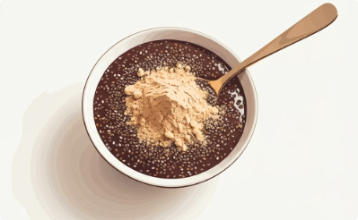
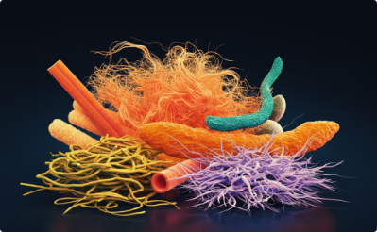
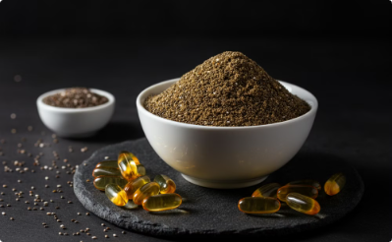
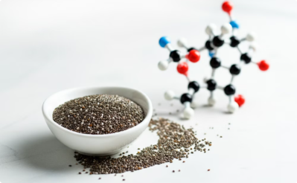
Nutritional Powerhouse: The Benefits of Chia Seeds
Protein Rich
Fiber Champion
Omega-3 Power
Complete AA Profile
Chia seeds offer a significant protein content (23% in whole seeds) , making them a great protein source.
Chia seeds are packed with dietary fiber (34% by weight), supporting digestive health, blood sugar regulation, and satiety.
Chia seeds are rich in omega-3 fatty acids (62-64% of their fat content), offering numerous health benefits, including reduced inflammation, heart health support, and enhanced brain function.
Essential Amino Acid Index (EAAI): 106% Amino Acid Chemical Score (AACS): 79% Methionine identified as the limiting amino acid [5]
The PRIMA programme is supported under Horizon 2020, the European Union’s Framework Programme for Research and Innovation
Notes:
"Beyond its agricultural benefits, chia is a nutritional powerhouse. Chia seeds offer a significant protein content of 23% in whole seeds, making them a great protein source. They are also a fiber champion, packed with 34% dietary fiber by weight, which supports digestive health, blood sugar regulation, and satiety. Chia seeds are rich in omega-3 fatty acids, constituting 62-64% of their fat content.These omega-3s offer numerous health benefits, including reduced inflammation, heart health support, and enhanced brain function6. Chia protein also presents a complete amino acid (AA) profile, with an Essential Amino Acid Index (EAAI) of 106% and an Amino Acid Chemical Score (AACS) of 79%6. Methionine has been identified as the limiting amino acid6."

Slide 6
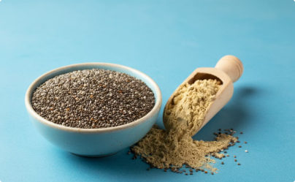

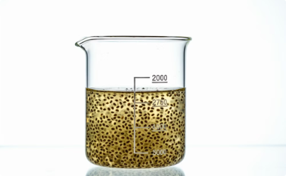

Preveously on ProxIMed…….. Exploring Defatting Methods
No Defatting (ND)
Mechanical Twin Screw Press (PD)
Solvent Extraction (HEX)
Supercritical Fluid CO2 Extraction (SCF)
This method involves no defatting, leaving the ground chia seeds in their natural state, retaining their full fat content.
This method utilizes a solvent, such as n-hexane, to remove fat from chia seeds, resulting in a product with significantly reduced fat content.
This technique uses a mechanical press to extract a portion of the fat from chia seeds, resulting in a partially defatted product.
This technique employs supercritical carbon dioxide, along with ethanol as a co-solvent, to extract fat from ground chia seeds, offering a more environmentally friendly alternative to traditional solvent extraction.
The PRIMA programme is supported under Horizon 2020, the European Union’s Framework Programme for Research and Innovation
Notes:
Previously in the ProxIMed project, we explored different defatting methods for chia seeds8. These included No Defatting (ND), where ground chia seeds retain their full fat content8; Mechanical Twin Screw Press (PD), a technique to extract a portion of the fat8; Solvent Extraction (HEX), using a solvent like n-hexane for significant fat reduction8; and Supercritical Fluid CO2 Extraction (SCF), using supercritical carbon dioxide with ethanol as a co-solvent as a more environmentally friendly alternative9."

Slide 7
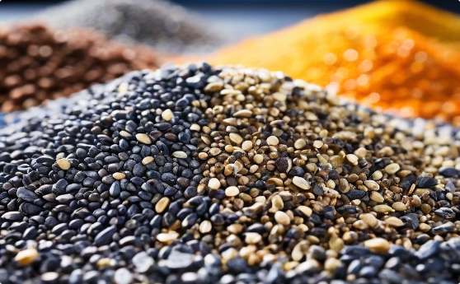
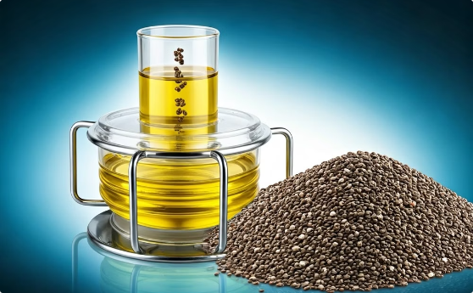

Study Aim
Introduction
Extraction Methods
Evaluation Metrics
This study explores efficient protein extraction methods from chia seeds. The primary objective is to determine the impact of different protein release methodsand their impact on protein yield and functionality.
Alkaline Solving/Isoelectric Precipitation
Enzyme assited Extraction
High Preasure Homogenisation assited Extraction
Ultrasound Assited Extraction
Total nitrogen content F=5,42
Protein Yield
Protein Solubility
Water Holding Capacity
Oil Binding Capacity
Foam Capacity
Foam Stability
Emulsion Capacity
Emulsion Stability
The PRIMA programme is supported under Horizon 2020, the European Union’s Framework Programme for Research and Innovation
Notes:
"Given these promising characteristics, the study aim is to explore efficient protein extraction methods from chia seeds6. The primary objective is to determine the impact of different protein release methods and their effect on protein yield and functionality. In this study, we investigated several protein extraction methods. These include:
1.
Alkaline Solving/Isoelectric Precipitation (AL/IEP)
2.
Enzyme Assisted Extraction (EA)
3.
High Pressure Homogenization Assisted Extraction (HPH)
4.
Ultrasound Assisted Extraction (US)"
"To evaluate the effectiveness of these methods, we used various metrics, including Total nitrogen content, Protein Yield, Protein Solubility, Water Holding Capacity (WHC), Oil Binding Capacity (OBC), Foam Capacity (FC), Foam Stability (FS), Emulsion Capacity (EC), and Emulsion Stability (ES)."

Slide 8
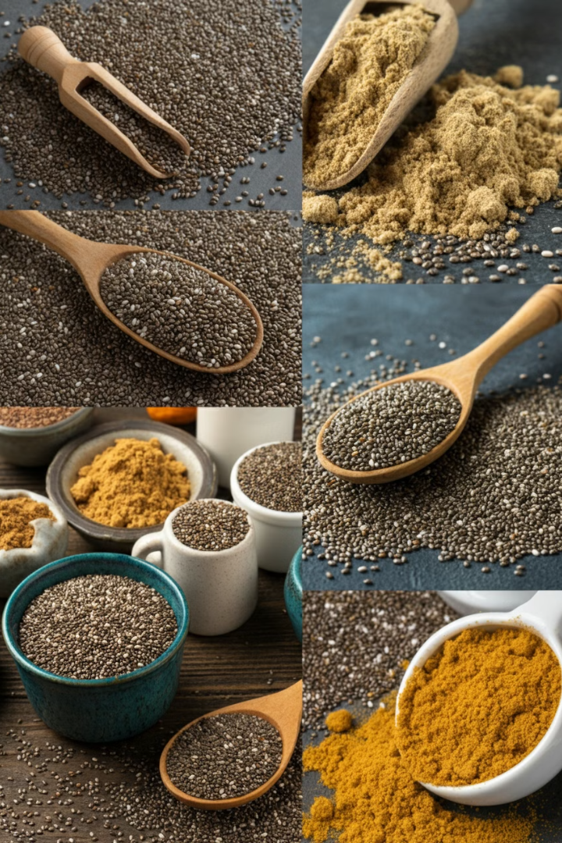
Raw Material Composition: Chia Flour and Whole Seeds
Raw Material
Fat (%)
Carbohydrates (%)
Fiber (%)
Protein (%)
Organic Chia Flour (O)
6.9
4.5
44.5
28.3
Conventional Whole Chia Seeds (C)
31.4
1.6
31.9
23.2
The PRIMA programme is supported under Horizon 2020, the European Union’s Framework Programme for Research and Innovation

Slide 9






Protein Extraction Processes - AL/IEP, EA, HPH, US
Homogenisation
3% (w/v)
Heat Treatment 2 h @ 55 °C @ pH 8
Enzyme assited Extraction (EA)
Novozymes Viscozyme L
1% according to mass
High Preasure Homogenization
(HPH ) 200 Bar 1 Cycle
700 Bar 2 Cycles
D95 < 100 µm
Ultra Sound (US)
60 WS/g
Stiring 30 min @ 21 °C @ pH 10
Centrifuge @ 4750 RCF, 20 min @ 4 °C
IEP pH 3,75
Centrifuge @ 4750 RCF, 20 min @ 4 °C
Sediment Neutralisation 30 min @ 21 °C, pH 7
Pasteurisation
10 min 80 °C
Freeze Drying
Washing 1x
The PRIMA programme is supported under Horizon 2020, the European Union’s Framework Programme for Research and Innovation
Notes:
Now, let's look at the protein extraction processes used in this specific study, which are AL/IEP, EA, HPH, and US
We utilized partially defatted chia flour as indicated in the Summary. The general process involved steps like homogenization at 3% (w/v), heat treatment at 55°C for 2 hours at pH 8, and stirring at 21°C for 30 minutes at pH 10. Isoelectric Precipitation (IEP) was carried out at pH 3.75, followed by centrifugation9. The sediment underwent neutralisation and freeze drying.... A washing step was also included. Pasteurisation was done at 80°C for 10 minutes."
"Specific to the methods:
•
Enzyme Assisted Extraction (EA) used Novozymes Viscozyme L at 1% according to mass.
•
Ultrasound (US) was applied at 60 WS/g11.
•
High Pressure Homogenization (HPH) involved 1 cycle at 200 Bar and 2 cycles at 700 Bar, aiming for a particle size D95 less than 100 µm
Viscozyme L: Cellulase, Pectinase, Hemi_Cellulase
Xylase (chia gel disruption)
Endo Glucanase-> Chia gel disruption

Slide 10
Protein Extraction fom Chia Seeds Results
a
a
a
a
a
b
a
c
c
a
a
b
b
b
c
d
c
b
d
Values with the same letter indicate no significant difference at α = 0.05.
The PRIMA programme is supported under Horizon 2020, the European Union’s Framework Programme for Research and Innovation
Notes:
Moving on to the results of the protein extraction.
This chart shows the Protein Yield, Protein Content in the extract, Dry Matter, and Protein Solubility for the different extraction methods (AL/IEP, EA, HPH, US) compared to the Raw chia. Values with the same letter indicate no significant difference at a significance level of α = 0.05
Looking at Protein Yield, we see variations among the methods. The EA method yielded the highest protein content at 56.7%, followed by IEP at 56.7%
US methods resulted in the highest protein yield.
For Protein Content in the dry matter of the extracts, the Raw chia flour had 25.6% protein. All extraction methods significantly increased the protein content compared to the raw all extraction methods were effective in concentrating the protein.
Protein Solubility shows that raw materialhad the highest solubility at 40.5%, significantly higher than IEP, EA, HPH, and US . The solubility of the Raw material was not influenced by the pasteurization compared to the extracted proteins

Slide 11
Results Functional Properties
a
b
a
c
b
c
c
d
Values with the same letter indicate no significant difference at α = 0.05.
The PRIMA programme is supported under Horizon 2020, the European Union’s Framework Programme for Research and Innovation
Notes:
Now let's look at the functional properties of the extracted proteins. First, the Oil and Water Holding Capacity. Values with the same letter indicate no significant difference at α = 0.05."
"For Water Holding Capacity (WHC), AL/IEP showed the highest capacity at 450.6%, significantly higher than EA (246.5%), HPH (253.7%), and US (413.3%). AL/IEP and US methods resulted in the highest water holding capacities.
For Oil Binding Capacity (OBC), US showed the highest capacity at 388 %, followed by EA (347%), AL/IEP (219%), and HPH (144%). Chia proteins offer excellent water and oil holding-key for juicy, moist products

Slide 12
Results Functional Properties
a
a,b
a,b
a
b
b,c
c
b
Values with the same letter indicate no significant difference at α = 0.05.
The PRIMA programme is supported under Horizon 2020, the European Union’s Framework Programme for Research and Innovation
Notes:
First I did not want to show this slide, Values low, SD thru the roof.
But it is a result, and the result is that the foaming ability is low,
Soy and pea protein, as well as egwhite are way better foaming agents

Slide 13
Results Functional Properties
a
a
a
Conclusion: 1. Chia Concentrates have high potential for EC/ES
2. Food Applications:
Mayonaise
Salad Dressings
Ice Cream
Margarine
Meat Alternatives
a
b
a
a
Values with the same letter indicate no significant difference at α = 0.05.
The PRIMA programme is supported under Horizon 2020, the European Union’s Framework Programme for Research and Innovation
Notes:
For Emulsion Capacity (EC), the values were very similar across all methods: AL/IEP (179.3%), EA (179.3%), HPH (182.2%), and US (179.1%)10. There was no significant difference between any of the methods for EC. This suggests that all tested methods resulted in extracts with similarly high emulsion capacity.
For Emulsion Stability (ES), AL/IEP showed the highest stability at 99.0%, followed by HPH (97.9%), US (96.2%), and EA (90.7%)10. There was no significant difference between AL/IEP, HPH, and US, but EA was significantly lower10. AL/IEP, HPH, and US methods resulted in high emulsion stability10."
The conclusion for Emulsion properties is that Chia Concentrates have high potential for EC/ES10. This makes them suitable for various food applications, such as Mayonnaise, Salad Dressings, Ice Cream, Margarine, and Meat Alternatives.

Slide 14
Conclusion
Method | Rank | Technical Ease | Production Speed | Key Functional Advantages
AL/IEP | 1st | High (simple, widely scalable) | Fast | Highest protein yield Moderate emulsion stability
US | 2nd | Medium-High (easy integration) | Fast | - Higher solubility - Superior oil binding capacity - Enhanced emulsion stability vs. IEP
HPH | 3rd | Medium (equipment-intensive) | Moderate | Best functional properties overall (emulsion/foam stability)
EA | 4th | Low (enzyme cost/control) | Moderate | Moderate improvements across metrics
The PRIMA programme is supported under Horizon 2020, the European Union’s Framework Programme for Research and Innovation
Notes:
For Emulsion Capacity (EC), the values were very similar across all methods: AL/IEP (179.3%), EA (179.3%), HPH (182.2%), and US (179.1%)10. There was no significant difference between any of the methods for EC. This suggests that all tested methods resulted in extracts with similarly high emulsion capacity.
For Emulsion Stability (ES), AL/IEP showed the highest stability at 99.0%, followed by HPH (97.9%), US (96.2%), and EA (90.7%)10. There was no significant difference between AL/IEP, HPH, and US, but EA was significantly lower10. AL/IEP, HPH, and US methods resulted in high emulsion stability10."
The conclusion for Emulsion properties is that Chia Concentrates have high potential for EC/ES10. This makes them suitable for various food applications, such as Mayonnaise, Salad Dressings, Ice Cream, Margarine, and Meat Alternatives.

Slide 15
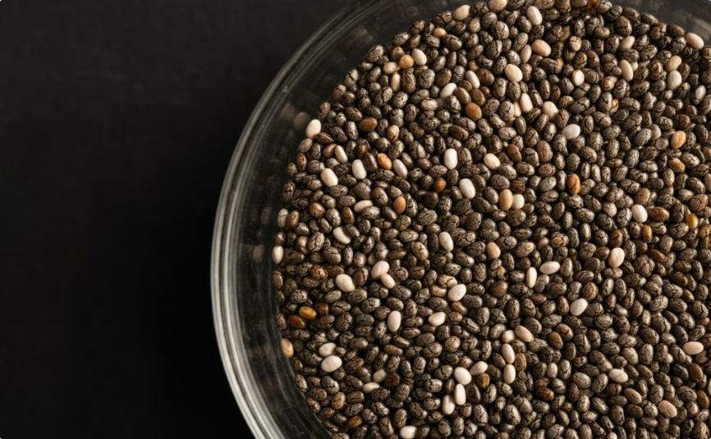

Summary and Outlook
Summary
Outlook
Chia Concentrates have high potential for EC/ES
Digestibility
Protein Content shall be increased
Allergenicity/Toxicity
Achieve reproducible results before upscale
Product development
Chia Protein Concentrate has high potential food applications
Life Cycle Assesment
The PRIMA programme is supported under Horizon 2020, the European Union’s Framework Programme for Research and Innovation
Notes:
Emulsifying capacity and stability: Chia protein shines! It matches or even surpasses soy and pea in creating stable emulsions, making it a fantastic candidate for products like mayonnaise, salad dressings, and even ice cream
Protein Content close to 60% close to requirements 0f ProxIMed (65%) 66% if we apply F=6,25 ;)

Slide 16

Acknowledgement
Funding:
University of Applied Sciences Weihenstephan-Triesdorf
Meet the Team:
Prof. Dr. Özlem Özmutlu
M. Sc. Patricia Maag P5.08 M. Eng. Lisa Ziegltrum P5.09
M. Eng. Simon Körber
This study has received funding from the European Union's Horizon 2020-PRIMA Section I Program under grant agreement #2232 (ProxIMed)
The PRIMA programme is supported under Horizon 2020, the European Union’s Framework Programme for Research and Innovation

Slide 17










Acknowledgement
Hochschule Weihenstephan-Triesdorf (HSWT)
GERMANY
Middle East Technical University (METU)
TURKIYE
Green Survey (GS)
GERMANY
TAT Gıda Inc.
TURKIYE
University of Sfax (UoS)
TUNISIA
American University of Berut (AUB)
LEBANON
Aristotle University Thessaloniki (AUTh)
GREECE
Focus Foodlabs (FFL)
GERMANY
Assiut University (AU)
EGYPT
AINIA
SPAIN
Deutsche Institut für Lebensmittel (DIL)
GERMANY
The PRIMA programme is supported under Horizon 2020, the European Union’s Framework Programme for Research and Innovation

Slide 18


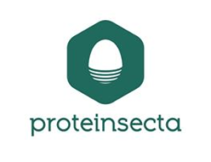



Acknowledgement
Malta College of Arts, Science and Technology (MCAST)
MALTA
Uluova Dairy Company (UL)
TURKIYE
Proteinsecta (PS)
SPAIN
University of Parma (UNIPR)
ITALY
Universidade Catolica Portuguesa (UCP)
PORTUGAL
Arid Regions Institute (IRA)
TUNISIA
The PRIMA programme is supported under Horizon 2020, the European Union’s Framework Programme for Research and Innovation

Slide 19




Thank you for your attention.
I am ready for your questions.
_____________________________________
HOCHSCHULE WEIHENSTEPHAN-TRIESDORF University of Applied Sciences
Institute of Food Technology M. Eng. Simon Dirr
Am Staudengarten 13 | 85354 Freising | Germany
T +49 (0)8161 71-2854
simon.dirr@hswt.de linkedin.com/in/simon-dirr-8a1544197
The PRIMA programme is supported under Horizon 2020, the European Union’s Framework Programme for Research and Innovation
https://proximedprima.eu/
Notes:
https://www.linkedin.com/company/91010026/admin/dashboard/

Slide 20
Acknowledgement
AI Disclaimer: This Presentation was partially created with Gamma AI: https://gamma.app/ Gramatic and spelling was corrected by Perplexity AI: https://www.perplexity.ai/
Sources
[1] Nagaraja, T. E.; Parveen, S. G.; Aruna, C.; Hariprasanna, K.; Singh, S. P.; Singh, A. K.; Joshi, D. C.; Joshi, P.; Tomar, S. M. S.; Talukdar, A. Kumar, S. Millets and pseudocereals: A treasure for climate resilient agriculture ensuring food and nutrition security. Indian Journal of Genetics and Plant Breeding (The) 2024, 01, S. 1–37, doi: 10.31742/ISGPB.84.1.1
[2] Diez, J.; Tiranti, J. A.; Sadras, V. O. Acreche, M. M. The critical period for grain yield in chia (. Crop and Pasture Science 2021, 3, S. 213–222, doi: 10.1071/CP20432
[3] KHAN, M. F.; YOUSAF, M. W. AKHTAR, L. H. A NEWLY APPROVED KABULI CHICKPEA VARIETY “ROHI-CHANA-21”: A BOOST UP IN THE EXISTING YIELD POTENTIAL OF CHICKPEA. Biological and Clinical Sciences Research Journal 2023, 1, S. 265, doi: 10.54112/bcsrj.v2023i1.265
[4] Sadras, V. O.; Rosewarne, G. M. Lake, L. Australian Lentil Breeding Between 1988 and 2019 Has Delivered Greater Yield Gain Under Stress Than Under High-Yield Conditions. Frontiers in plant science 2021, S. 674327, doi: 10.3389/fpls.2021.674327
[5] Ferreira, D. M.; Nunes, M. A.; Santo, L. E.; Machado, S.; Costa, A. S. G.; Álvarez-Ortí, M.; Pardo, J. E.; Oliveira, M. B. P. P. Alves, R. C. Characterization of Chia Seeds, Cold-Pressed Oil, and Defatted Cake: An Ancient Grain for Modern Food Production. Molecules (Basel, Switzerland) 2023, 2, doi: 10.3390/molecules28020723
The PRIMA programme is supported under Horizon 2020, the European Union’s Framework Programme for Research and Innovation

