Slide 1



Empowering research talents in alternative proteins across Europe’s widening countries.
Prof. Dr. Mecit Halil Öztop
Middle East Technical University
APRISE Coordinator

Slide 2


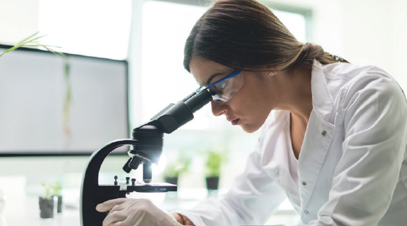

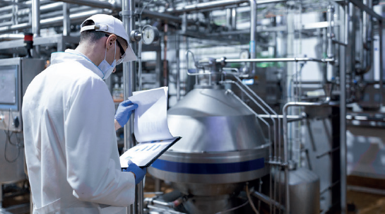
03
What is APRISE?
04
Why is APRISE Needed?
05
What Does APRISE Do?
06
Structure of APRISE
07
Who is Involved?
08
What Will APRISE Achieve?
09
How to Join APRISE
10
2
ENFiber COST Action

Slide 3







"Empowering research talents in alternative proteins across Europe’s widening countries. "
WHAT IS
APRISE is a
Horizon Europe ERA Talents project designed to strengthen research and innovation (R&I) capacity on alternative proteins in widening countries through hands-on training, cross-sectoral mobility, and stakeholder collaboration.
Our Mission
To equip widening country researchers and institutions with the skills, experience, and networks needed to drive the sustainable protein transition.
Our Vision
A Europe where innovation in alternative proteins is inclusive, connected, and equally accessible regardless of geography or sector.
Our Goals
Support talent mobility across sectors and borders
Deliver multidisciplinary training in science, entrepreneurship, and communication
Promote open science, gender balance, and inclusiveness in all activities
Integrate alternative protein innovations into local and regional food systems
Engage stakeholders, citizens, and policymakers in shaping the protein transition
Enhance research management and institutional capacities
4
3

Slide 4





WHY IS
Why are APros Needed?
APros reduce resource use and greenhouse gas emissions^{2,3}​
EU countries invested heavily in 2024:
€38M by Germany⁴
€60M by the Netherlands⁵
€168M by Denmark⁵
€65M by France⁵
€7M by Spain⁶
PROTEIN CRISIS
Global demand for protein is rising while traditional systems remain unsustainable.¹
NEEDED?
APRISE is a
Horizon Europe ERA Talents project designed to strengthen research and innovation (R&I) capacity on alternative proteins (APros) in widening countries through hands-on training, cross-sectoral mobility, and stakeholder collaboration.
REGIONAL GAPS
Widening countries face limited Access to infrastructure, funding, and innovation networks.
Why Widening Countries?
Rich biodiversity and favorable agricultural conditions.
          Still underrepresented in APros research due to:
          -Limited infrastructure
          -Regulatory gaps
          -High production costs
Huge untapped potential for sustainable food innovation
TALENT DRAIN
Skilled researchers often leave due to lack of career opportunities and support.
DISCONNECTED ACTORS
Academia, industry, and civil society rarely collaborate effectively in the alternative protein field.
¹IPCC, 2023, https://www.ipcc.ch/report/ar6/syr/
²Good Food Institute, https://gfi.org/resource/environmental-impacts-of-alternative-proteins/
³https://doi.org/10.1038/s41538-024-00291-w
⁴https://gfieurope.org/blog/federal-budget-2024-germany-invests-38-million-euros-in-the-protein-transition-and-sets-out-to-become-a-leader-in-the-field/
⁵https://www.europarl.europa.eu/RegData/etudes/BRIE/2023/751426/EPRS_BRI(2023)751426_EN.pdf
⁶https://www.foodnavigator.com/Article/2023/11/20/german-government-to-boost-alternative-proteins-with-38m-investment
4

Slide 5

Skills Training
60+ training events in scientific, digital, entrepreneurial, and communication skills.
Career
Support
Provides individual career development plans, mentoring, and long-term career coaching to strengthen professional growth.
Public Engagement
Equips researchers
with science communication skills and supports dialogue with citizens, policymakers, and stakeholders.
Talent Mobility
Supports over 250 secondments across academia, industry, NGOs, and innovation hubs, tailored for researchers and managers.
5

Slide 6




STURCUTRE OF APRISE
Led by Middle East Technical University Food Engineering Department (Türkiye), APRISE is structured around five core pillars:
2
Skills Development
3
Innovation Integration
4
Institutional Transformation
5
Society & Policy
1
Talent Mobility
Delivers targeted training on protein science, research support, communication, and responsible research practices. Activities are tailored for researchers, research managers, and support staff.
Strengthens links between research and application. Researchers work with practitioners to address real challenges in sustainable food systems and alternative proteins.
Improves research environments in widening countries by supporting human resources, upgrading support services, and encouraging inclusive participation in international projects.
Involves citizens, consumers, and decision-makers in shaping the direction of protein transitions. Activities include public outreach, policy discussions, and multi-actor engagement.
Facilitates secondments between universities, research centers, NGOs, and companies across countries and sectors. Participants gain practical experience, expand their networks, and build lasting collaborations.
6

Slide 7
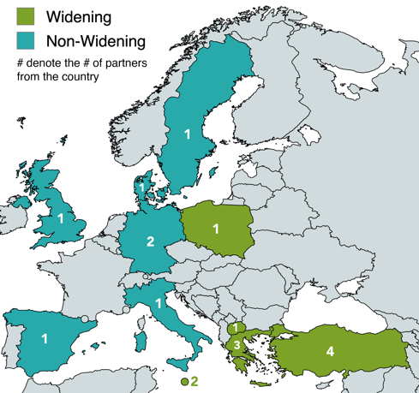





















Who is Involved?
APRISE brings together a diverse consortium of 18 partners from 11 countries, combining academic excellence with practical expertise across the alternative protein landscape.
11 Widening
7 Non-Widening
5 Academic
13 Non-Academic
Middle East Technical University
Türkiye
MyBiotech GmbH
Germany
Nutri Biotech Services Ltd. Malta
EcoVibes - Environmental Consultants
Greece
Nordic Horizon Institute
Sweeden
OpenCom Italy
Italy
Warsaw University of Life Sciences
Poland
Agricultural University of Athens
Greece
Advanced Climate Risk Education
Germany
Nottingham Trent University
UK
Telewander ApS
Denmark
Institute of Agrifood Research and Technology
Spain
BKEA Ltd
Malta
BITKIDEN
Türkiye
Green Growth Platform
Republic of Macedonia
Theta Biomarkers
Greece
Technology Development Foundation of Turkey
Türkiye
Sutas Dairy Company
Türkiye
7

Slide 8
What Will We Achieve?
Stronger Talent, Stronger Systems
We will support the growth of over 250 individuals through training, mentoring, and secondments.
Better Research Skills
Researchers and staff will gain new capacities in scientific methods, project management, communication, and open science.
More Connected Institutions
Widening country organizations will form long-term links with experienced partners across Europe.
A More Inclusive Food Future
Alternative protein research will better reflect regional needs, social values, and cultural contexts through public engagement and policy dialogue.
Practical Tools and Outputs
Open-access training materials, institutional development plans, and mobility frameworks that others can reuse and adapt.
8

Slide 9

How to Join?
Are you a researcher or research manager based in a widening country?
You can apply for upcoming secondments, trainings, and mentoring calls. We offer opportunities tailored to both academic and non-academic profiles.
Stay Updated
Follow us on LinkedIn
Sign up for our mailing list to receive open calls and updates
/apriseproject
aprise@metu.edu.tr
9

Slide 10



Building a European network to transform food waste into functional, fiber-based solutions.
Prof. Dr. Mecit Halil Öztop
Middle East Technical University
Main Proposer of the Action
10

Slide 11



"Building a European network to transform food waste into functional, fiber-based solutions."
WHAT IS
A COST Action building a pan-European research and innovation community focused on developing fiber-based, bio-degradable food packaging from agricultural and food processing side streams.
It bridges food science, packaging technology, material science, and sustainability policy across sectors and countries.
Our Mission
To build a cross-sectoral European network that promotes the valorization of food industry side streams into sustainable fiber-based materials for food, health, and environmental applications.
Our Vision
A Europe where food system waste is no longer discarded but transformed into high-value fiber products through scientific collaboration, innovation, and circular economy principles.
Our Goals
Establish an interdisciplinary network of experts
Identify and characterise fiber-rich agri-food side streams
Strengthen collaboration between academia, industry, and policy
Advance methods for extraction, modification, and application
Support early-career researchers and ensure inclusiveness
Promote sustainable uses of fibers in food, health, and materials
Enable future joint research, innovation, and standardisation
Increase awareness and knowledge transfer across sectors
11

Slide 12
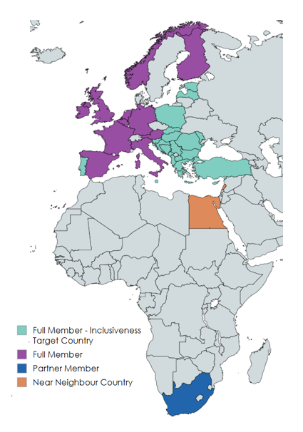

Who is Involved?
ENFIBER is a COST Action supported by the European Cooperation in Science and Technology (COST), bringing together a growing network of researchers and stakeholders across Europe and beyond.
35+ countries involved (including EU member states, Near Neighbor Countries, and International Partner Countries)
Participants from academia, research institutes, SMEs, NGOs, and public bodies
Inclusiveness Target Countries (ITCs) are actively represented
Open to new members throughout the action duration
The Action is organised around:
Management Committee (MC): Representatives from each country guide strategic direction
Working Groups (WGs): Focused on topics like fiber sourcing, processing, applications, and dissemination
Core Group: Oversees coordination, training schools, STSMs, and stakeholder outreach
12

Slide 13

THANK YOU
Prof. Dr. Mecit Halil Öztop
Middle East Technical University
Main Proposer of the Action
mecit@metu.edu.tr
aprise@metu.edu.tr
/apriseproject
enfiber@metu.edu.tr

