Slide 1





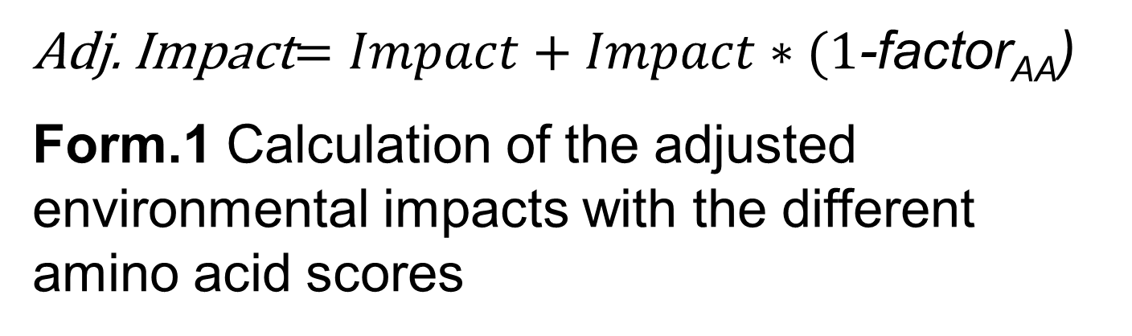
Including protein quality in LCA of novel food products
GreenSurvey GmbH, Germany ¹
University of Parma²
M.Sc. Andreas Geß ¹,
Dr. Sara Cutroneo²,
Prof. Dr. Barbara Prandi²,
Prof. Dr. Tullia Tedeschi²,
Introduction
Novel food products are being developed to achieve a nutritional progression while also providing an ecological advantage to their conventional counterparts. McAuliffe et al. 2022 introduced a method to integrate protein quality in the life cycle assessment (LCA) of food products based on its DIAAS score to make the possible uptake of protein from different sources comparable¹. For novel food products, however, a DIAAS score is hardly calculatable, as it has to estimated for each ingredient of a commercial food product and therefore, uncertainty is multiplied with each additional ingredient. Thus, a scheme needs to be developed to include protein quality in LCA based on the amino acid composition.
Materials and Methods
Results
To investigate the protein, the sum of Essential Amino Acids is calculated [mg/g of protein] and compared with the EAA of egg protein as reference.
To deeper investigate the adequacy of this protein, the Amino Acid Score (AAS) is assessed for each essential amino acid as the ratio between the single amino acid content [mg/ g of protein] and the corresponding requirement pattern for that specific amino acid [mg/1 g of protein]. The AAS is a measure of the quality of a protein based on its essential amino acid composition. The AAS of each sample can be based on the requirement pattern for two population groups: children (3-18 years old) and adults (18-65 years old), as outlined in FAO/WHO, 2011.² The amino acid with the lowest score is identified as the limiting amino acid, which can negatively affect the overall quality of the protein, limiting the usage by the body of the other amino acids for protein synthesis. The AAS of novel food products are set into relation by comparing it to the AAS of egg.
The LCA is conducted following the framework provided according to the norms DIN EN ISO 14040 and 14044. For the calculation of the environmental impact categories, the PEF3.1 rules are applied. The use of the AAS as a factor as a measurement of protein quality was calculated in the manner proposed by McAuliffe et al. 2022, who multiplied the LCA impacts with the DIAAS [%].
As an exemplary case, the intermediate results of the LCA of protein production from tomato pomace is used. The modelling as well as the assessment of the amino acids is conducted with internal data from the ProxIMed project. For now, this data is confidential and is only used as proof-of-concept.
Protein | Tomato pomace
EAA [mg/g protein] | 379 | 512
AAS, based on: | requirements for adults | egg reference protein
His | 1.51 | 1.03
Ile | 1.47 | 0.82
Leu | 1.17 | 0.80
Lys | 0.55 | 0.36
SAA | 1.73 | 0.67
AAA | 2.27 | 0.93
Thr | 1.67 | 0.82
Trp | 1.00 | 0.35
Val | 1.27 | 0.75
The results of the protein analysis are shown in table 1.
The sum of EAA of protein powder from tomato pomace is 379.2 ± 8.2 mg/g of protein. This value was observed to be lower than the sum of EAA estimated for the egg reference protein (512 mg/g of protein). Anyhow the value fulfilled the requirements set by FAO/WHO for both adults and children.²
The tomato pomace showed low scores compared to the egg reference proteins, with most of the scores for essential amino acids below 0.80 and the limiting amino acid being tryptophan, which as the score of 0.35. This means that in the human body, when eaten, the protein (if it is 100% digestible) can be utilized at the 35%. Adults appear more representative for the novel food products since the products the developed in ProxIMed are not aimed to fulfill special needs of certain groups of population. All essential amino acids showed values of AAS ≥ 1, with the only exception of lysine. Consequently, Lysine is the limiting amino acid here, having a score of 0.55. This means that eating the tomato protein alone, if it is 100% digestible, 55% of protein can be utilized at max.
The effects of using the results from the protein analysis as a factor for protein quality on LCA results are shown in figure 1. Here the preliminary results for the category of climate change is used.
To include the overall EAA, the relation of EAA of tomato pomace protein and egg protein is used (0.74) Therefore it can be seen that using egg protein as a reference has, using the limiting protein AAS the intermediate and using the overall EAA in relation to egg the lowest the highest increase of the results.
The adjusted impacts are calculated according to [1]. Formula 1 shows their calculation scheme. This is applied for all shown factors (EAA 0.74, AAS_{egg} 0.35 and AAS_{lim} 0.55).
Tab. 1 Total amount of essential amino acids and the amino acid score of the essential amino acids and their corresponding requirement patterns for protein from tomato pomace. The marked amounts are used as adjusting factors.
Fig. 1 Effect of the different protein quality factors on the impact factor climate change as an example.
Adj. Impact$=Impact+Impact∗(1$-factor_{AA})
Form.1 Calculation of the adjusted environmental impacts with the different amino acid scores
Conclusion
This poster shows the first steps of the intended inclusion of protein quality into Life Cycle assessment.
An evaluation will be made to find the most sensible factor of the proposed three. Furthermore, other novel protein products will be investigated. For this the protein sources within the ProxIMed project will be assessed for EAA, AAS and environmental impacts. This includes- besides protein for tomato pomace – protein from tomato leaves, lentil, duckweed sesame cake, date by-products, microalgae, mycoprotein, sesame, insects, faba beans, chia seed and mallow.
Additionally, the protein products can be improved. E.g, plant-based products are usually made of a mixture of vegetable-based protein sources. Therefore, the score can be improved combining the tomato pomace protein with legume-based products, known to be a good source of lysine. In this way it is possible to achieve a better balance in amino acids and improve the protein usage.
References
Funding
1 McAuliffe, G.A., Takahashi, T., Beal, T. et al. Protein quality as a complementary functional unit in life cycle assessment (LCA). Int J Life Cycle Assess 28, 146–155 (2023). https://doi.org/10.1007/s11367-022-02123-z
2 FAO/WHO. (2011). Dietary Protein Quality Evaluation in Human Nutrition. In Food and Agriculture Organization of the United Nations. https://www.fao.org/ag/humannutrition/35978-02317b979a686a57aa4593304ffc17f06.pdf
3 Centro Alimenti, 2019 CREA Centro Alimenti e Nutrizione. (2019). Tables of Food Composition. https://www.alimentinutrizione.it/sezioni/tabelle-nutrizionali
This study has received funding from the European Union's Horizon 2022-PRIMA Section I Program under grant agreement #2232 (ProxIMed)

Slide 2
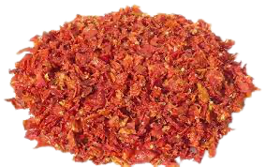
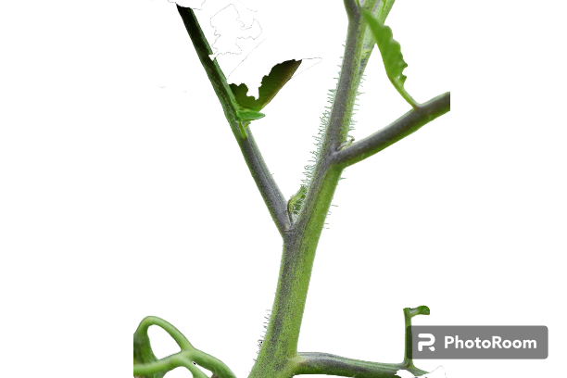
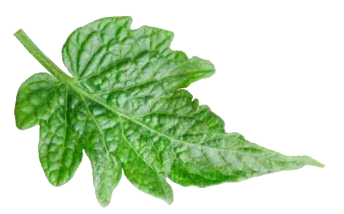
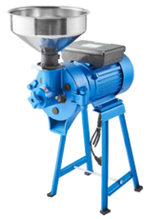
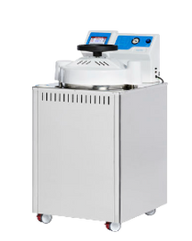
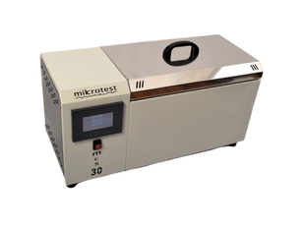
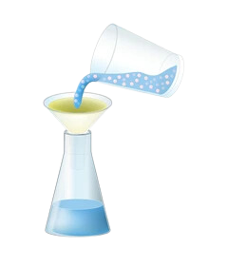

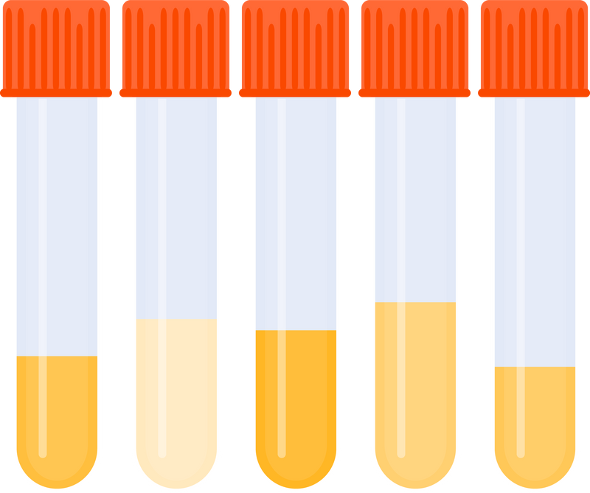
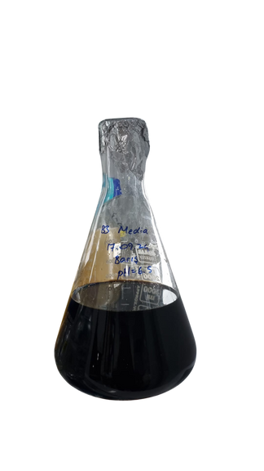
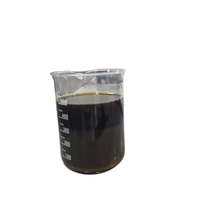
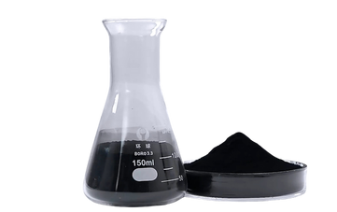



Waste streams from tomato cultivation and production
GreenSurvey GmbH, Germany 1
Middle East Technical University²
University of Applied Sciences Weihenstephan-Triesdorf, Germany³
M.Sc. Andreas Geß ¹,
Prof. Dr. Mecit Öztop² Ayşe Sultan Akgun², Duygu Menteş²,
Prof. Dr. Özlem Özmutlu Karslioglu³,
Introduction
Tomato plays a pivotal role in the Mediterranean diet. The by-product of tomato processing, known as tomato pomace, has garnered attention for its nutritional and textural qualities, making it suitable for both feed and food applications. Despite its potential, there is currently a lack of defined technologies for scaling up the production of these products for widespread use. Due to its protein content, tomato pomace presents an opportunity to serve as a valuable protein source. Additionally, tomato leaves yield a relevant amount of protein to be processed into protein powder. While both raw materials show a high potential for converting a waste material in a valuable substance, studies are hardly found or still non-existent. Within the project ProxIMed, various technologies to extract proteins from tomato pomace and tomato leaves are tested on their technological feasibility but also on their ecological sensibility. For this purpose, a Life Cycle Assessment (LCA) of the process schemes is conducted.
Tomato pomace
Tomato stems and leaves
On a food technical level, the transformation of tomato pomace into a fermentable substrate using various hydrolysis methods is explored. This involves examining the impact of the type of hydrolysis, solvent concentration, and pretreatment duration on process efficiency. By quantifying biomass conversion, the reduction in tomato pomace waste through effective valorisation can be assessed. The fermentable sugars derived from tomato pomace are then used in subsequent fermentation to produce single-cell protein and other valuable bioproducts, highlighting the potential for waste reduction and sustainable product generation in the tomato processing industry.
Current treatment process flow:
The by-products of tomato plantation, majorly tomatoes parts, stems, and leaves mostly left on the fields after the harvest, forms the largest quantity of any agricultural biomass residues. Up to now tomato stems and leaves are not used. The challenges are to create:
A clear fermentation medium → titration to clear impurities along with pectinase enzyme to prevent turbidity.
A toxin-Free medium Tomato leaves contain bioactive metabolites, such as steroidal alkaloids and phenolics → activated charcoal treatment
Medium with reduced sugar content Determined through HPLC analysis.
Current treatment process flow:
Grinding
Hydrothermal Pretreatment
Enzymatic Hydrolysis (cellulase and pectinase)
Without chemicals at 121°C for 15 min
at 200 rpm and 50 °C for 18 hours
Grinding
Alkaline Pretreatment
Enzymatic Hydrolysis
Filtration
with 1%NaOH at 121°C for 15 min
with cellulase and pectinase
Titration
Measuring absorbance at 575 nm
DNS to measure reducing sugar
Arrangement of pH 8.8 & 6.5
At pH=5.0 for hydrolysate
Fermentation Medium
Weight & moisture content measurement
Drying left over biomass
Filtration
Removal of precipitate
Autoclave Pretreatment
Activated Charcoal Treatment
Removal of precipitate
at 121°C for 15 min
1% activated charcoal treatment at pH 6.5 for 1 hour
Benefits and effects on the LCA impacts
Funding
LCA consists of the four phases goal & scope, inventory collection, impact assessment and interpretation. All environmental impacts are calculated per amount of created product, i.e. the functional unit of a production system. If waste streams are used two effects can arise:
The waste doesn’t need to be treated, so the overall impacts are lowered. Further, the waste is viewed as burden-free and products made from often have low impacts.
The waste is transformed into a by-product and the impacts are then allocated to both the main product and the by-product, meaning lower impacts for both products.
In general, using waste closes production circles, which is a central encouragement provided by the application of LCA and has effect on all four phases, especially on interpretation as system outline have to be re-thought when wastes become useable resources The use of tomato waste streams is further investigated in the ProxIMed project.
This study has received funding from the European Union's Horizon 2022-PRIMA Section I Program under grant agreement #2232 (ProxIMed)
Notes:
References :
Kılmanoğlu, H., Hoşoğlu, M. İ., Güneşer, O., & Yüceer, Y. K. (2021). Optimization of pretreatment and enzymatic hydrolysis conditions of tomato pomace for production of alcohols and esters by Kluyveromyces marxianus. LWT, 138, 110728. https://doi.org/10.1016/j.lwt.2020.110728
Hijosa-Valsero, M., Garita-Cambronero, J., Paniagua-García, A. I., & Díez-Antolínez, R. (2019). Tomato Waste from Processing Industries as a Feedstock for Biofuel Production. BioEnergy Research, 12(4), 1000–1011. https://doi.org/10.1007/s12155-019-10016-7
Miller, GL. (1959). Use of dinitro salicylic acid reagent for determination of reducing sugar. Anal Chem.; 31: 426- 427.

